Slide 1
Elections and Electoral Systems

Slide 2
Democracies are sometimes classified in terms of their electoral system.
An electoral system is a set of laws that regulate electoral competition between candidates or parties or both.

Slide 3
Elections and Electoral Integrity

Slide 4
Elections are increasingly used to fill legislative and executive offices around the world.
Almost all of the world’s independent states today use direct elections to elect people to their lower house of parliament.

Slide 5
Legislative and Presidential Elections by Decade
350
300
250
200
150
100
50
0
1950s 1960s 1970s 1980s 1990s 2000s 2010s
Number of Elections
Presidential Legislative

Slide 6
Electoral integrity refers to the extent to which the conduct of elections meets international standards and global norms concerning ‘good’ elections.
These norms and standards are usually set out in treaties, conventions, and guidelines issued by international and regional organizations.

Slide 7
Violations of electoral integrity are referred to as electoral malpractice.

Slide 8
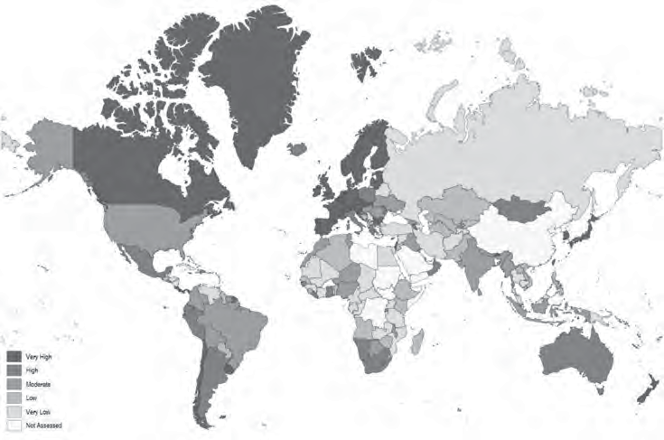
Very High High Moderate Low
Very Low
Not Assessed
Electoral Integrity, 2021

Slide 9
United States
South Korea
PEI Index Electoral Authorities
PEI Index Electoral Authorities
Laws
Laws
Results
Procedures
Results
Procedures
Count
Boundaries
Count
20
40
60
80
100
Boundaries
20
40
60
80
100
Finance
Media
Voting
Voter Registration
Voting
Voter Registration
Party Registration
Finance
Party Registration
Media
Belarus
Egypt
PEI Index Electoral Authorities
PEI Index Electoral Authorities
Laws
Laws
Results
Procedures
Results
Procedures
Count
Boundaries
Count
Boundaries
20
40
60
80
Finance ¹⁰⁰
Media
20
40
60
80
100
Finance
Media
Voting
Voter Registration
Voting
Voter Registration
Party Registration
Party Registration

Slide 10
Democracies tend to have higher levels of electoral integrity than dictatorships.
There’s variation, though, among both democracies and dictatorships.

Slide 11
Electoral integrity is influenced by:
Domestic structural constraints
The role of the international community
Institutional design
Electoral management bodies

Slide 12
Two strategies to identify election fraud:
Election monitoring
Election forensics

Slide 13
Benford’s Law: Frequency Distribution of First and Second Digits
0 | 1 | 2 | 3 | 4 | 5 | 6 | 7 | 8 | 9 | MEAN
E | 0.301 | 0.176 | 0.125 | 0.097 | 0.079 | 0.067 | 0.058 | 0.051 | 0.046 | 3.441
0.120 | 0.114 | 0.109 | 0.104 | 0.100 | 0.097 | 0.093 | 0.090 | 0.088 | 0.085 | 4.187

Slide 14
Electoral Systems

Slide 15
Political scientists typically distinguish between electoral systems based on their electoral formula.
Majoritarian
Proportional
Mixed
An electoral formula determines how votes are translated into seats.

Slide 16
Electoral System Families
Electoral System Families
Majoritarian
Proportional
Mixed
Plurality
Absolute Majority
List PR
Single Transferable Vote
Independent
Dependent
Single-Member District Plurality Single Nontransferable Vote Block Vote
Party Block Vote Borda Count Modified Borda Count Limited Vote
TRS: Majority-Plurality
Alternative Vote TRS: Majority-Runoff
Coexistence Supposition Fusion
Correction Conditional
Quota
Divisor
Hare Hagenbach-Bischoff
Droop Imperiali
Reinforced Imperiali
d’Hondt Sainte-Laguë
Modified Sainte-Laguë

Slide 17
Majoritarian Electoral Systems

Slide 18
A majoritarian electoral system is one in which the candidates or parties that receive the most votes wins.

Slide 19
A single-member district plurality system (SMDP) is one in which individuals cast a single vote for a candidate in a single-member district.
The candidate with the most votes wins.

Slide 20
Bedford Constituency, UK Legislative Elections, 2019
CANDIDATE | PARTY | VOTES | PERCENTAGE
MOHAMMAD YASIN | LABOUR | 20,491 | 43.3
RYAN HENSON | CONSERVATIVE | 20,346 | 43.0
HENRY VANN | LIBERAL DEMOCRAT | 4,608 | 9.7
ADRIAN SPURRELL | GREEN | 960 | 2.0
CHARLES BUNKER | BREXIT | 896 | 1.9

Slide 21
The single nontransferable vote (SNTV) is a system in which voters cast a single candidate-centered vote in a multimember district.
The candidates with the highest number of votes are elected.

Slide 22
Whereas SMDP and SNTV are ‘plurality’ majoritarian electoral systems, the alternative vote is an ‘absolute majority’ majoritarian system.
The alternative vote (AV), sometimes called the instant-runoff vote, is a candidate-centered preference voting system used in single-member districts where voters rank order the candidates.

Slide 23
If a candidate wins an absolute majority of first-preference votes, they’re immediately elected.
If no candidate wins an absolute majority, the candidate with the fewest first-preference votes is eliminated, and their votes are reallocated among the remaining candidates based on the designated second preferences.
This process is repeated until one candidate has obtained an absolute majority of the votes cast (full preferential system) or an absolute majority of the valid votes remaining (optional preferential system).

Slide 24
Richmond Constituency, New South Wales, Australia 1990
 | FIRST COUNT |  | SECOND COUNT |  | THIRD COUNT |  | FOURTH COUNT |  | FIFTH COUNT |  | SIXTH COUNT |  | SEVENTH COUNT
CANDIDATE | (NO.) | (%) | (NO.) | (%) | (NO.) | (%) | (NO.) | (%) | (NO.) | (%) | (NO.) | (%) | (NO.) | (%)
STAN GIBBS | 4,346 | 6.3 | 4,380 | 6.3 | 4,420 | 6.4 | 4,504 | 6.5 | 4,683 | 6.8
NEVILLE NEWELL | 18,423 | 26.7 | 18,467 | 26.7 | 18,484 | 26.8 | 18,544 | 26.9 | 18,683 | 27.1 | 20,238 | 29.4 | 34,664 | 50.5
GAVIN BAILLIE | 187 | 0.3
ALAN SIMS | 1,032 | 1.5 | 1,053 | 1.5 | 1,059 | 1.5 | 1,116 | 1.6
IAN PATERSON | 445 | 0.6 | 480 | 0.7 | 530 | 0.8
DUDLEY LEGGETT | 279 | 0.4 | 294 | 0.4
CHARLES BLUNT | 28,257 | 40.9 | 28,274 | 41.0 | 28,303 | 41.0 | 28,416 | 41.2 | 28,978 | 42 | 29,778 | 43.2 | 33,980 | 49.5
HELEN CALDICOTT | 16,072 | 23.3 | 16,091 | 23.3 | 16,237 | 23.5 | 16,438 | 23.8 | 16,658 | 24.1 | 18,903 | 27.4

Slide 25
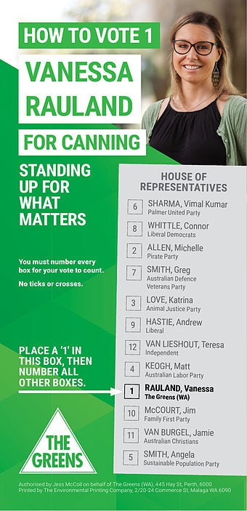
Australian How-To-Vote Card, Green Party, Canning Constituency, 2015

Slide 26
The majority-runoff two-round system (TRS) is another ‘absolute majority’ majoritarian electoral system.

Slide 27
In a majority-runoff TRS voters cast a single candidate-centered vote in a single-member district.
Any candidate who obtains an absolute majority in the first round of elections is elected.
If no one obtains an absolute majority, then the top two vote winners go on to compete in a runoff election in the second round.

Slide 28
Burundi Presidential Elections, 2020
FIRST ROUND
CANDIDATE | PARTY | VOTE SHARE (%)
ÉVARISTE NDAYISHIMIYE | CNDD-FDD | 71.45
AGATHON RWASA | NATIONAL CONGRESS FOR LIBERTY | 25.15
GASTON SINDIMWO | UNION FOR NATIONAL PROGRESS | 1.70
DOMITIEN NDAYIZEYE | KIRA BURUNDI COALITION | 0.57
LéONCE NGENDAKUMANA | FRONT FOR DEMOCRACY IN BURUNDI | 0.49
DIEUDONNé HAHIMANA | INDEPENDENT | 0.43
FRANCIS ROHERO | INDEPENDENT | 0.21

Slide 29
Uruguay Presidential Elections, 2019
FIRST ROUND
CANDIDATE | PARTY | VOTE SHARE (%)
DANIEL MARTINEZ | BROAD FRONT | 40.49
LUIS ALBERTO LACALLE POU | NATIONAL PARTY | 29.70
ERNESTO TALVI | COLORADA PARTY | 12.80
GUIDO MANINI RíOS | OPEN CABILDO | 11.46
CéSAR VEGA | PARTIDO ECOLOGISTA RADICAL INTRANSIGENTE | 1.43
EDGARDO NOVICK | PARTIDO DE LA GENTE | 1.12
PABLO MIERES | INDEPENDENT PARTY | 1.01
GONZALO ABELLA | POPULAR UNITY | 0.84
GUSTAVO SALLE | GREEN ANIMALIST PARTY | 0.83
OTHERS |  | 0.33
SECOND ROUND
DANIEL MARTINEZ | BROAD FRONT | 49.21
LUIS ALBERTO LACALLE POU | NATIONAL PARTY | 50.79

Slide 30
Proportional Electoral Systems

Slide 31
A proportional, or proportional representation (PR), electoral system is a quota- or divisor-based electoral system employed in multimember districts.
The rationale behind PR systems is to produce a proportional translation of votes into seats.

Slide 32
Proportional representation (PR) electoral systems come in two main types:
List proportional representation systems (List PR)
Single transferable vote (STV)

Slide 33
In a list PR system, each party presents a list of candidates to voters in each multimember district.
Parties receive seats in proportion to their overall share of the votes.
These seats are then allocated among the candidates on their list.

Slide 34
List PR systems differ in important ways:
The precise formula for allocating seats to parties
The district magnitude
The use of electoral thresholds
The type of party list employed

Slide 35
All PR systems employ either quotas or divisors to allocate seats to parties.

Slide 36
A quota is essentially the ‘price’ in terms of votes that a party must ‘pay’ to guarantee themselves a seat in a particular electoral district.

Slide 37
A quota, Q(n), is calculated as
Q(n) = ^{Vd}
M_{d} + n
V_{d} is the number of valid votes in district d.
M_{d} is the district magnitude or number of available seats in district d.
n is the modifier of the quota.

Slide 38
Q(n) = ^{Vd}
M_{d} + n
Hare quota: n = 0.
Hagenbach-Bischoff quota: n = 1.
Imperiali quota: n = 2.
Reinforced imperiali quota: n = 3.
The Droop quota is the Hagenbach-Bischoff quota plus 1.

Slide 39
Allocating Seats to Parties using the Hare Quota
 | PARTY A | PARTY B | PARTY C | PARTY D | PARTY E | PARTY F | TOTAL
VOTES | 47,000 | 16,000 | 15,800 | 12,000 | 6,100 | 3,100 | 100,000
SEATS |  |  |  |  |  |  | 10
QUOTA |  |  |  |  |  |  | 10,000
VOTES ÷ QUOTA | 4.7 | 1.6 | 1.58 | 1.2 | 0.61 | 0.31
AUTOMATIC SEATS | 4 | 1 | 1 | 1 | 0 | 0 | 7
REMAINDER SEATS |  |  |  |  |  |  | 3

Slide 40
Allocating Seats to Parties using the Hare Quota
 | PARTY A | PARTY B | PARTY C | PARTY D | PARTY E | PARTY F | TOTAL
VOTES | 47,000 | 16,000 | 15,800 | 12,000 | 6,100 | 3,100 | 100,000
SEATS |  |  |  |  |  |  | 10
QUOTA |  |  |  |  |  |  | 10,000
VOTES ÷ QUOTA | 4.7 | 1.6 | 1.58 | 1.2 | 0.61 | 0.31
AUTOMATIC SEATS | 4 | 1 | 1 | 1 | 0 | 0 | 7
REMAINDER SEATS |  |  |  |  |  |  | 3
What about the ‘remainder’ seats?

Slide 41
The most common method for allocating the remainder seats is the largest remainder method.
Hare Quota with Largest Remainders
 | PARTY A | PARTY B | PARTY C | PARTY D | PARTY E | PARTY F | TOTAL
VOTES | 47,000 | 16,000 | 15,800 | 12,000 | 6,100 | 3,100 | 100,000
SEATS |  |  |  |  |  |  | 10
QUOTA |  |  |  |  |  |  | 10,000
VOTES ÷ QUOTA | 4.7 | 1.6 | 1.58 | 1.2 | 0.61 | 0.31
AUTOMATIC SEATS | 4 | 1 | 1 | 1 | 0 | 0 | 7
REMAINDER | 0.7 | 0.6 | 0.58 | 0.2 | 0.61 | 0.31
REMAINDER SEATS | 1 | 1 | 0 | 0 | 1 | 0 | 3
TOTALSEATS | 5 | 2 | 1 | 1 | 1 | 0 | 10

Slide 42
A divisor, or highest average, system divides the total number of votes won by each party in a district by a series of numbers (divisors) to obtain quotients.
District seats are then allocated according to which parties have the highest quotients.

Slide 43
The three most common divisor systems are:
D’Hondt: 1, 2, 3, 4, . . .
Sainte-Laguë: 1, 3, 5, 7, . . .
Modified Sainte-Laguë: 1.4, 3, 5, 7, . . .

Slide 44
Allocating Seats to Parties using the d’Hondt Divisor System
 | PARTY A | PARTY B | PARTY C | PARTY D | PARTY E | PARTY F | TOTAL
VOTES | 47,000 | 16,000 | 15,800 | 12,000 | 6,100 | 3,100 | 100,000
SEATS |  |  |  |  |  |  | 10
VOTES ÷ 1 | 47,000 (1) | 16,000 (3) | 15,800 (4) | 12,000 (6) | 6,100 | 3,100
VOTES ÷ 2 | 23,500 (2) | 8,000 (9) | 7,900 (10) | 6,000 | 3,050 | 1,550
VOTES ÷ 3 | 15,666 (5) | 5,333 | 5,266 | 4,000 | 2,033 | 1,033
VOTES ÷ 4 | 11,750 (7) | 4,000 | 3,950 | 3,000 | 1,525 | 775
VOTES ÷ 5 | 9,400 (8) | 3,200 | 3,160 | 2,400 | 1,220 | 620
VOTES ÷ 6 | 7,833 | 2,667 | 2,633 | 2,000 | 1,017 | 517
TOTAL SEATS | 5 | 2 | 2 | 1 | 0 | 0 | 10

Slide 45
The key factor influencing the proportionality of an electoral system is the district magnitude.
District magnitude refers to the number of representatives elected in a district.
The larger the district magnitude, the greater the degree of proportionality.

Slide 46
There’s considerable variation in district magnitude across countries.
In 2006 and 2007, Ukraine had a district magnitude of 450.
Serbia currently has a district magnitude of 250. Historically, Chile had a district magnitude of 2.

Slide 47
All proportional electoral systems have an electoral threshold.
An electoral threshold is the minimum level of support a party needs to obtain representation.

Slide 48
A natural threshold is a mathematical by-product of the electoral system.
A formal threshold is explicitly written into the electoral law.
Electoral system proportionality is low when the electoral threshold is high.

Slide 49
Electoral thresholds can have negative side-effects.
In Turkey 2002, so many parties failed to surpass the 10% threshold that fully 46% of all votes were wasted.
In Poland 1993, 34% of the votes were wasted, allowing the former Communists to return to power.

Slide 50
In a closed party list, the order of candidates elected is determined by the party itself, and voters aren’t able to express a preference for a particular candidate.
In an open party list, voters can indicate not just their preferred party, but also their favored candidate within that party.
In a free party list, voters have multiple votes they can allocate either within a single party list or across different party lists.

Slide 51
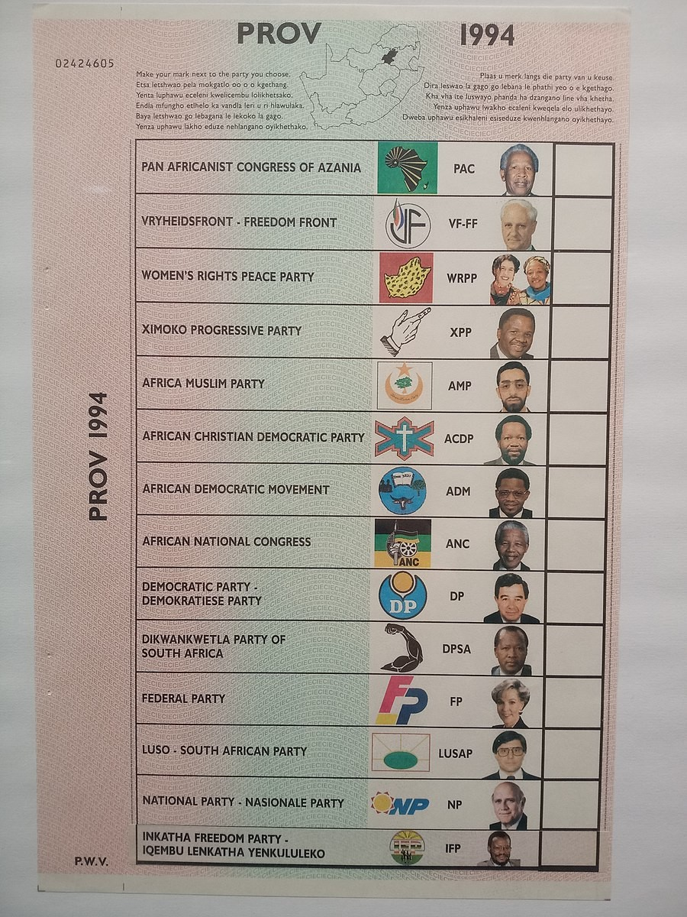

Slide 52
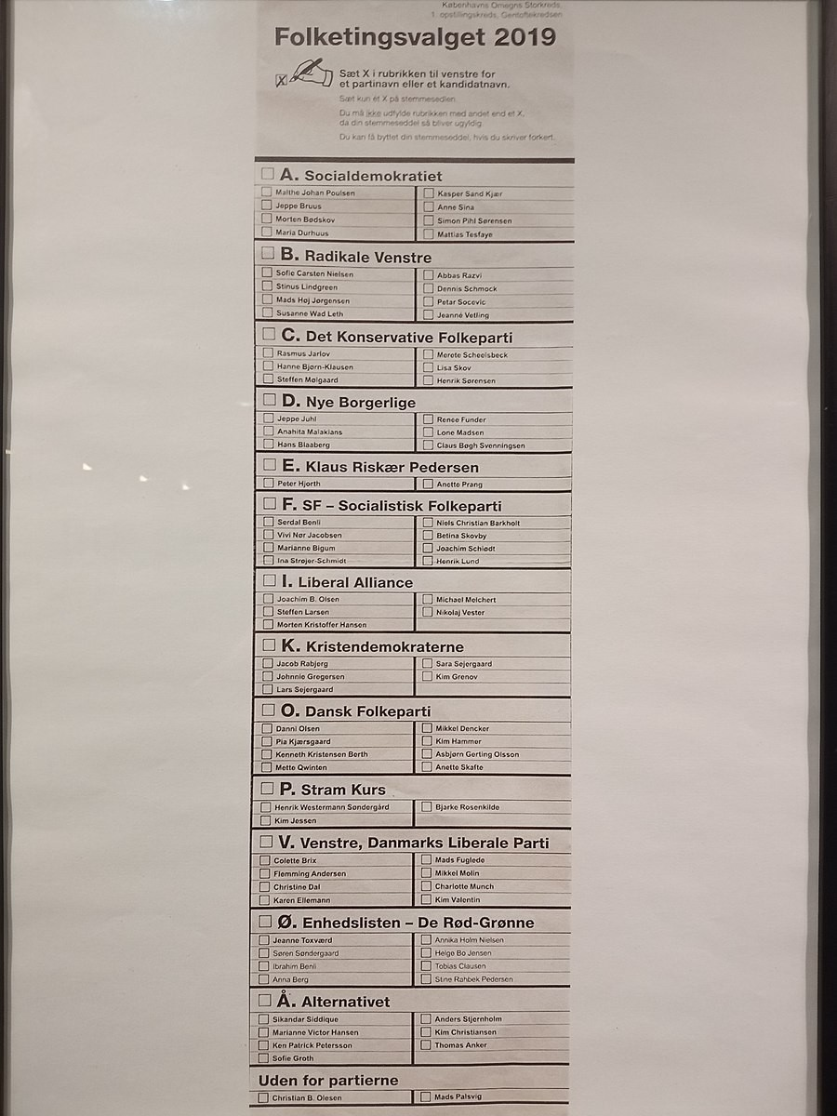

Slide 53
The only proportional electoral system that doesn’t employ a party list is the single transferable vote.
The single transferable vote (STV) is a candidate-centered preferential voting system used in multimember districts.

Slide 54
In STV systems, candidates that surpass a specified quota of first-preference votes are immediately elected.
In successive counts, voters from eliminated candidates and surplus votes from elected candidates are reallocated to the remaining candidates until all the seats are filled.

Slide 55
STV example
District magnitude is 3.
20 voters.
5 candidates: Bruce, Shane, Sheila, Glen, and Ella.
Droop quota: [20/(3 + 1)] + 1 = 6

Slide 56
Results from 20 Ballots in an STV System
VOTING ROUND | AAAA | BB | CCCCCCCC | DDDD | E | F
1ST | BRUCE | SHANE | SHEILA | SHEILA | GLEN | ELLA
2ND | SHANE | BRUCE | GLEN | ELLA
3RD |  |  | ELLA | GLEN

Slide 57
STV in a 3-Seat District with 20 Voters
CANDIDATES
VOTING ROUND | BRUCE | SHANE | SHEILA | GLEN | ELLA | RESULT
1ST | AAAA | BB | CCCCCCCC DDDD | E | F | SHEILA IS ELECTED, AND SHEILA’S SURPLUS VOTES ARE REALLOCATED.
2ND | AAAA | BB | CCCC DD | E CCCC | F DD | SHANE IS ELIMINATED.
3RD | AAAA BB |  | CCCC DD | E CCCC | F DD | BRUCE IS ELECTED.
4TH | AAAA BB |  | CCCC DD | E CCCC | F DD | ELLA IS ELIMINATED, AND GLEN IS ELECTED.

Slide 58
STV systems, click here

Slide 59
Mixed Electoral Systems

Slide 60
A mixed electoral system is one in which voters elect representatives through two different systems, one majoritarian and one proportional.

Slide 61
Most mixed systems employ multiple electoral tiers.
An electoral tier is a level at which votes are translated into seats.
The lowest electoral tier is the district or constituency level. Higher tiers are constituted by grouping together different lower-tier constituencies, typically at the regional or national level.

Slide 62
In a mixed system, it’s typically the case that a majoritarian system is used in the lowest tier (district level) and a proportional system is used in the upper tier (regional or national level).

Slide 63
There are two basic types of mixed systems.
An independent mixed electoral system is one in which the majoritarian and proportional components of the electoral system are implemented independently of one another.
A dependent mixed electoral system is one in which the application of the proportional formula is dependent on the distribution of seats or votes produced by the majoritarian formula.

Slide 64
Translating Votes into Seats in an Independent Mixed System
 | Votes won in each electoral district |  |  |  |  | National district votes won | Seats won
 | 1 | 2 | 3 | 4 | 5 |  | % of votes won | SMDP | List PR | Total
Party A | 3,000 | 3,000 | 3,000 | 3,000 | 3,000 | 15,000 | 60 | 5 | 3 | 8
Party B | 2,000 | 2,000 | 2,000 | 2,000 | 2,000 | 10,000 | 40 | 0 | 2 | 2
Total | 5,000 | 5,000 | 5,000 | 5,000 | 5,000 | 25,000 | 100 | 5 | 5 | 10

Slide 65
In most dependent mixed systems, individuals have two votes.
One vote is for the representative at the district level (candidate vote).
One vote is for the party list in the higher electoral tier (party vote).

Slide 66
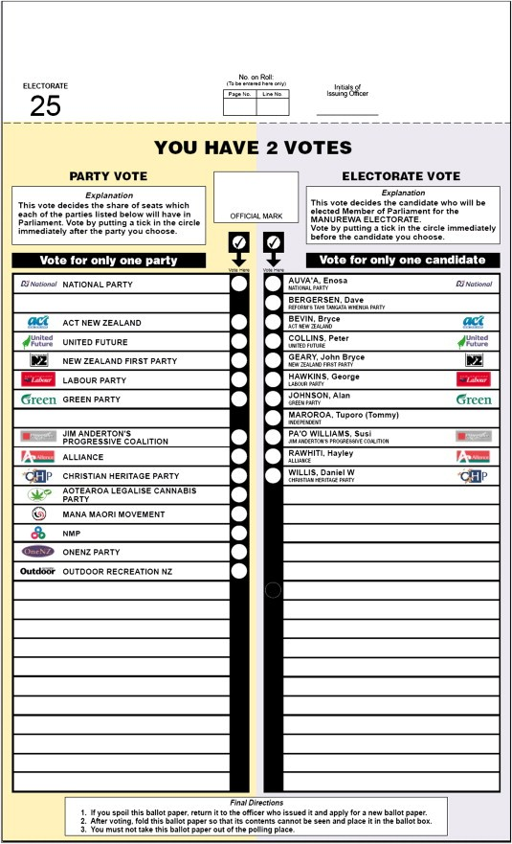

Slide 67
Translating Votes into Seats in a Dependent Mixed System
 | Votes won in each electoral district |  |  |  |  | National district votes won | Seats won
 | 1 | 2 | 3 | 4 | 5 |  | % of votes won | SMDP | List PR | Total
Party A | 3,000 | 3,000 | 3,000 | 3,000 | 3,000 | 15,000 | 60 | 5 | 1 | 6
Party B | 2,000 | 2,000 | 2,000 | 2,000 | 2,000 | 10,000 | 40 | 0 | 4 | 4
Total | 5,000 | 5,000 | 5,000 | 5,000 | 5,000 | 25,000 | 100 | 5 | 5 | 10

