Slide 1
Parties, Party Systems, and Party Competition

Slide 2
A political party can be thought of as a group of people that includes those who hold office and those who help get and keep them there.

Slide 3
Political parties serve four main purposes:
Structure the political world
Recruitment and socialization of political elite
Mobilization of the masses
The link between rulers and the ruled

Slide 4
Party Systems

Slide 5
A nonpartisan democracy has no official political parties.
A single-party system is one in which only one political party is legally allowed to hold power.
A one-party dominant system is one in which multiple parties may legally operate but in which only one particular party has a realistic chance of gaining power.
A two-party system is one in which only two major political parties have a realistic chance of holding power.
A multiparty system is one in which more than two parties have a realistic chance of holding power.

Slide 6
The effective number of parties is a measure that captures both the number and the size of the parties in a country.
The measure weights larger parties greater than smaller parties.

Slide 7
The effective number of electoral parties is a measure of the
number of parties that win votes:
1ggg
.
Σ
2
𝑖
v
The effective number of legislative parties is a measure of the
number of parties that win seats:
1ggg
.
Σ
2
𝑖
s

Slide 8
Types of Political Parties

Slide 9
Where do parties come from?
The primordial, or bottom-up, view of party formation treats parties as the natural representatives of people who share common interests.
Parties form to represent the interests of natural divisions or social cleavages in society.

Slide 10
The instrumental, or top-down, view of party formation treats parties as teams of office seekers and focuses on the role played by political elites and entrepreneurs.
Political parties are created by individuals who, perhaps because of certain informational advantages, are able to discern an opportunity to represent a previously unrepresented interest.
These political entrepreneurs may even help citizens become aware that such an interest exists.

Slide 11
Why are some party systems divided primarily along ethnic lines, while others are divided mainly along class, religious, linguistic, or regional ones?

Slide 12
One of the roles of parties is to represent social cleavages.
Urban-rural cleavage
Confessional cleavage
Secular-clerical cleavage
Class cleavage
Post-materialist cleavage
Ethnic and linguistic cleavages

Slide 13
Populism
There are three necessary components to populism:
People-centrism
Anti-pluralism
Moralized politics

Slide 14
Populism has no programmatic content of its own.
It’s more of a discursive ‘wrapper’ that can be attached to a wide range of ideologies across the left-right divide.
It’s the ‘host’ ideologies such as nationalism or environmentalism that are ‘wrapped’ in populist discourse that give populism its actual policy content.

Slide 15
When attached to nationalism, we get a right-wing and exclusionary populism that targets immigrants and ethnic minorities as enemies of the people.
When attached to socialism or environmentalism, we get a more left-wing and often inclusionary populism that typically views economic elites and capitalism as the source of problems.
Populism is used by parties on the left, the center, and the right.

Slide 16
Populism is a strategy that all parties can adopt.
Populism isn’t a distinct ideological party family.
Instead, we have socialist, conservative, liberal and other parties that sometimes find it strategic to adopt populist rhetoric to sell their policies and sometimes find it strategic not to do so.

Slide 17
Theorizing about Politicized Cleavages
Individuals have a repertoire of attributes – religion, language, class, gender etc. – that makes them eligible for membership in some identity category.

Slide 18
An attribute is a characteristic that qualifies an individual for membership in an identity category.
Attributes are given and self-evident.
An identity category is a social group in which an individual can place themself.
Identity categories are socially constructed.

Slide 19
Attributes and Possible Combinations of Attributes in a Hypothetical Country
 | French speaker | Dutch speaker
Northerner | a | b
Southerner | c | d
Note: Letters indicate the proportion of the population embodying each possible combination of attributes.

Slide 20
Potential Identity Categories in a Hypothetical Country
Potential identity category | Size
Northerner | a + b
Southerner | c + d
French speaker | a + c
Dutch speaker | b + d
Northerner and French speaker | a
Northerner and Dutch speaker | b
Southerner and French speaker | c
Southerner and Dutch speaker | d
Everyone | a + b + c + d

Slide 21
How attributes map onto actual identity categories depends on the distribution and correlation of those attributes.
A country with uncorrelated attributes has cross-cutting attributes (cleavages).
A country with correlated attributes has reinforcing attributes (cleavages).

Slide 22
Cross-Cutting Attributes
 | French speaker | Dutch speaker
Northerner | 0.25 | 0.25
Southerner | 0.25 | 0.25
North vs. South and French-speaking vs. Dutch-speaking are as equally likely to be activated as French-speaking Northerner, Dutch-speaking Northerner, French-speaking Southerner, or Dutch-speaking Southerner.

Slide 23
Reinforcing Attributes
 | French speaker | Dutch speaker
Northerner | 0.03 | 0.57
Southerner | 0.36 | 0.04
The identity categories that are likely to be activated are Dutch-speaking Northerners and French-speaking Southerners.

Slide 24
Electoral rules also influence which cleavages become politicized.
A Hypothetical Distribution of Attributes
 | French speaker | Dutch speaker
Northerner | 0.40 | 0.10
Southerner | 0.40 | 0.10
Country A: Gaining national office requires 50% of the vote.
Country B: Gaining national office requires 60% of the vote.

Slide 25
A Hypothetical Distribution of Attributes
 | French speaker | Dutch speaker
Northerner | 0.40 | 0.10
Southerner | 0.40 | 0.10
Country A (50%): North vs. South (regional cleavage).
Country B (60%): French vs. Dutch (linguistic cleavage).

Slide 26
The distribution of cleavages also matters.
Country C: Gaining national office requires 60% of the vote.
 | French speaker | Dutch speaker
Northerner | 0.40 | 0.10
Southerner | 0.40 | 0.10
French vs. Dutch (linguistic cleavage).

Slide 27
The distribution of cleavages also matters.
Country D: Gaining national office requires 60% of the vote.
 | French speaker | Dutch speaker
Northerner | 0.25 | 0.35
Southerner | 0.25 | 0.15
North vs. South (regional cleavage).

Slide 28
Zambia and Malawi
$$\frac{2}{3}$$
$$\frac{1}{3}$$
of Chewas and Tumbukas live in Malawi, and live in Zambia.
Puzzle:
Malawi: Chewas and Tumbukas are arch political enemies.
Zambia: Chewas and Tumbukas are political allies.

Slide 29
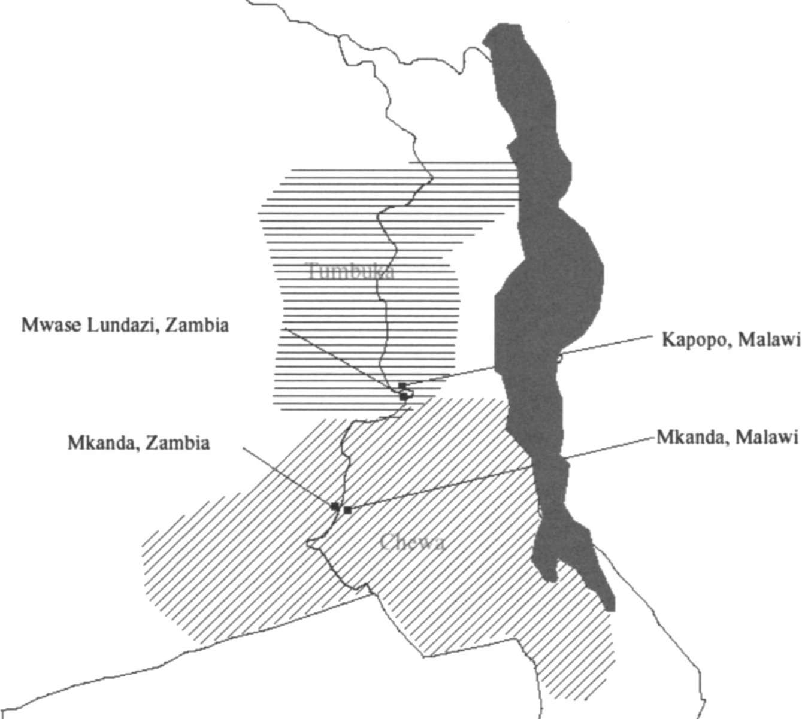

Slide 30
There are recognizable cultural differences between Chewas and Tumbukas.
Chewas speak Chichewa, while Tumbukas speak Chitumbuka.
Chewas dance nyau, while Tumbukas dance vinbuza.
Chewa parents want a chicken for their daughter, while Tumbuka parents want seven cows.

Slide 31
Would a member of your ethnic group vote for a presidential candidate from the other ethnic group?
Zambia: 21% said “No”.
Malawi: 61% said “No”.

Slide 32
Would you marry a member from the other ethnic group?
Zambia: 24% said “No”.
Malawi: 55% said “No”.

Slide 33
Chewas and Tumbukas are allies in Zambia and enemies in Malawi.
Why?

Slide 34
The two countries employ the same electoral system – SMDP.
They have both had similar party systems. They’re both former British colonies.

Slide 35
Malawi
Chewas (57%) and Tumbukas (12%).
Given their size and electoral system, it made sense to politicize the Chewa-Tumbuka division.
Malawi Congress Party (MCP) was seen as the Chewa party.
Alliance for Democracy (AFORD) was seen as the Tumbuka party.

Slide 36
Zambia
Chewas (7%) and Tumbukas (4%).
Given their size and electoral system, it didn’t make sense to politicize the Chewa-Tumbuka division.
The division was between the Easterners (Chewas and Tumbukas), Northerners, Westerners, and Southerners.
Chewas and Tumbukas had to work together if they hoped to win political power.

Slide 37
The logic of political competition focuses voter and elite attention on some cleavages and not others.
Politicians seek to build political coalitions that allow them to win power.
Not all cultural and ethnic divisions become politicized.

Slide 38
Politicized Cleavages and the Role of Electoral Institutions
Latent social cleavages
Electoral institutions
Politicized social cleavages

Slide 39
The Number of Political Parties

Slide 40
Why do some countries have many parties and others have few?

Slide 41
Duverger’s Theory
Social divisions are the primary driving force behind the formation of parties.
Electoral institutions influence how social divisions are translated into political parties.

Slide 42
Social cleavages matter.
The more social cleavages there are and the more that they’re cross-cutting, the greater the demand for distinctive representation and the greater the demand for political parties.

Slide 43
Cross-Cutting Cleavages in Country A
 | Catholic | Protestant
Rich | 25 | 25
Poor | 25 | 25
High demand for political parties.

Slide 44
Reinforcing Cleavages in Country A
 | Catholic | Protestant
Rich | 0 | 50
Poor | 50 | 0
Low demand for political parties.

Slide 45
Electoral institutions matter.
Social cleavages create the demand for political parties.
But electoral institutions determine whether this latent demand for representation leads to the formation of new parties.
Majoritarian or non-proportional electoral systems act as a brake on the tendency for social cleavages to be translated into new parties.

Slide 46
Electoral institutions influence party system size through two mechanisms.
The mechanical effect of electoral laws.
The strategic effect of electoral laws.

Slide 47
Mechanical effect of electoral laws.
The mechanical effect of electoral laws refers to the way votes are translated into seats.
When electoral systems are disproportional, the mechanical effect punishes small parties and rewards large parties.

Slide 48
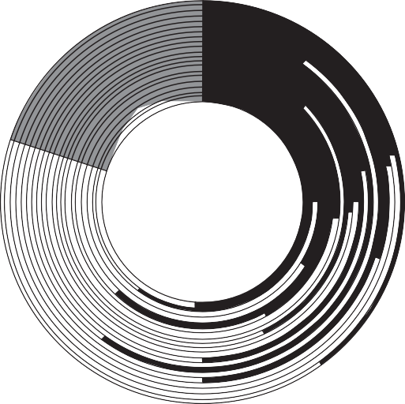
Duvergerland: A Hypothetical Country using an SMDP Electoral System
Business
Labor Green

Slide 49
Distribution of Seats under SMDP and PR Electoral Rules
a. SMDP
b. PR
Business Labor Green

Slide 50
St. Ives Constituency, United Kingdom, 1992
 | Votes | % of Vote
David Harris (Conservative) | 24,528 | 42.9
Andrew George (Liberal Democrat) | 22,883 | 40.1
Stephen Warr (Labour) | 9,144 | 16.0
Graham Stevens (Liberal) | 577 | 1.0
Harris is elected

Slide 51
National Election Results, United Kingdom, 1992
 | Votes | Seats
Conservative | 41.9 | 51.6
Labour | 34.9 | 41.6
Liberal Democrats | 17.8 | 3.1
Others | 5.4 | 3.7
Total | 100 | 100

Slide 52
Distribution of Votes and Seats in UK Elections, 1992
Distribution of votes
Distribution of seats
_{3%} 4%
5%
18%
42%
51%
Conservative
Labour
Liberal Democrats Other
42%
35%

Slide 53
Strategic effect of electoral laws.
The strategic effect of electoral laws refers to how the way in which votes are translated into seats influences the strategic behavior of voters and political elites.

Slide 54
When electoral systems are disproportional, their mechanical effect can be expected to punish small parties and reward large parties.
As a result, voters have an incentive to engage in strategic voting and political elites have an incentive to engage in strategic entry.

Slide 55
Strategic voting essentially means voting for your most preferred candidate or party that has a realistic chance of winning.
Strategic entry refers to whether political elites choose to enter the political scene under the label of their most preferred party or under the label of their most preferred party that has a realistic chance of winning.

Slide 56
St. Ives Constituency, United Kingdom, 1992
 | Votes | % of Vote
David Harris (Conservative) | 24,528 | 42.9
Andrew George (Liberal Democrat) | 22,883 | 40.1
Stephen Warr (Labour) | 9,144 | 16.0
Graham Stevens (Liberal) | 577 | 1.0
Harris is elected
Preference ordering: Labour>Liberal Democrat>Conservative
Sincere voting: Labour
Strategic voting: Liberal Democrat

Slide 57
Imagine you’re an aspiring political entrepreneur who has an interest in environmental politics.
If you lived in Duvergerland with an SMDP electoral system, which party would you join – greens, labor, or business?

Slide 58
Imagine you’re an aspiring political entrepreneur who has an interest in environmental politics.
If you lived in Duvergerland with an SMDP electoral system, which party would you join – greens, labor, or business?
Strategic entry means that small parties are less likely to attract high-quality candidates and funding, or even form in the first place, in a country with a disproportional electoral system.

Slide 59
Party Systems: Social Cleavages and the Modifying Effects of Electoral Institutions
Latent social cleavages
Electoral institutions
Politicized social cleavages
Strategic effect of electoral institutions
Duverger’s theory
Electoral parties
Mechanical effect of electoral institutions
Legislative parties

Slide 60
The Interplay of Social Heterogeneity and Electoral System Proportionality on Party System Size
 | Electoral System Permissiveness
 |  | Low (SMDP) | High (PR)
Social Heterogeneity | High | Few parties | Many parties
 | Low | Few parties | Few parties

Slide 61
Technically, Duverger’s theory only holds at the district level.
There can be more parties competing nationally than there are, on average, competing in each district.
A party system is nationalized if the local and national party systems are of similar size.

Slide 62
Number of Parties at the National and District Levels in the US, 1790-1990
7
6
5
4
3
2
1
Effective Number of Parties
0
1790 1800 1810 1820 1830 1840 1850 1860 1870 1880 1890 1900 1910 1920 1930 1940 1950 1960 1970 1980 1990
Year
National level
District level

Slide 63
What affects the nationalization of party systems?
Fiscal centralization.
Political centralization.
Concurrent presidential elections.
National cleavage patterns.

Slide 64
Party Competition

Slide 65
Policy
Parties often compete with each other by offering different policy packages.
Parties compete by moving in the policy space in an attempt to attract voters.

Slide 66
Spatial models typically assume that voters engage in proximity voting where they vote for the party located closest to them.
Most spatial models assume a one-dimensional ‘left-right’ policy space.

Slide 67
With two parties, the median voter theorem predicts that parties converge on the position of the median voter.
As the number of parties increase, parties are expected to disperse out in the policy space.
Parties in a multiparty system offer voters a variety of distinct ideological choices.

Slide 68
The spatial model can be extended to a multidimensional policy space.
However, the concept of ‘distance’ is more complicated as voters may care about some policy dimensions more than others.

Slide 69
Distance in a Two-Dimensional Spatial Model
Voter
Party 1
Policy 2
Party 2
Policy 1
Parties can compete not only by changing their policy position but also by changing how much voters care about the different policy dimensions.

Slide 70
Issue Competition
Issue competition is when parties compete by trying to strategically shape how much voters care about different issues.
Parties emphasize some issues more than others in their campaign communications.
They try to influence issue salience.

Slide 71
A high yield issue is one on which a party is united and where the party’s position is widely shared in the electorate.
A low yield issue is one on which a party is internally divided and where the party’s position enjoys only limited electoral support.
Parties will emphasize high yield issues rather than low yield issues.

Slide 72
According to issue ownership theory, parties should emphasize issues they ‘own’ rather than issues that are owned by other parties.
A party owns an issue if voters perceive it to be more competent or credible at dealing with it.

Slide 73
Issue competition predicts that parties won’t engage in head-to-head policy contests where they talk about their competing positions on the same issue.
Instead, they’ll focus their campaigns on different issues that they think are most beneficial to themselves or potentially detrimental to their opponents.

Slide 74
Issue entrepreneurship occurs when parties appeal to voters by emphasizing new issues.
Challenger parties tend to engage in issue entrepreneurship more than established mainstream parties.

Slide 75
Established mainstream parties can adopt three strategies when responding to new parties:
Dismissive strategy.
Accommodative strategy.
Adversarial strategy.

Slide 76
Valence Competition
Voters don’t just care about policy preferences at election time.
They also care about the non-policy characteristics of parties such as their competence, integrity, trustworthiness, leader quality, and experience.
These non-policy characteristics are called valence issues.

Slide 77
Valence issues are things that most people agree on, and which usually have to do with the effectiveness of policy delivery.
Voters prefer high valence parties to low valence parties.
Parties invest resources to improve their valence among voters.

Slide 78
Valence is especially important when it comes to policies on which parties hold similar positions.
Most parties promise economic growth, lower crime, better schools, and improved healthcare.
While parties can’t engage in significant policy competition when they hold the same policy positions, they can engage in valence competition where they try to convince voters they’re generally more competent, trustworthy, and capable than their opponents.

Slide 79
Policy competition, issue competition, and valence competition all fall under the heading of programmatic politics.

Slide 80
Programmatic politics:
Ideologically consistent and coherent policy platforms.
Parties attempt to implement their policy platforms in office.
Policy delivery is governed by formalized and public rules.
The delivery of goods and services is typically provided by an impersonal and nonpartisan bureaucracy.
The receipt of goods and services isn’t contingent on the provision of political support.

Slide 81
Parties can also compete by engaging in nonprogrammatic politics.

Slide 82
The key feature of nonprogrammatic politics is that the delivery of goods and services is discretionary and not based on formalized rules that have been made public.
Parties don’t develop detailed policy platforms to appeal to voters.
Instead, they compete with each other to win electoral support by using their discretion to provide goods and services to particular groups and individuals.

Slide 83
Clientelistic Politics
Clientelistic politics is a form of nonprogrammatic politics where the distribution of goods and services is made conditional on the provision of political favors by the recipients.
When clientelistic benefits are targeted at voters, we often talk about vote buying or turnout buying.

Slide 84
For clientelism to work as a form of quid pro quo, parties require a lot of fine-grained information.
One solution to this informational problem is to employ individuals called brokers to be their agents in local communities.
Brokers tend to be powerful local notables who, due to their networked position in a community, claim to have the information that parties desire.

Slide 85
Brokers target party resources to their followers and clients.
In return for the benefits, brokers request that their clients provide some sort of political favor such as participating in a rally or voting for a particular party.

Slide 86
Competing brokers who wish to be ‘hired’ by parties try to outdo each other by building larger and more reliable client networks.
Brokers essentially ‘sell’ their client networks to parties in return for resources, which, among other things, can be used to build and maintain a local power base.

Slide 87
Parties face a principal-agent problem with respect to their brokers.
Parties want their resources to be targeted to swing voters.
But brokers tend to give too many resources to party loyalists because they’re ‘cheaper’ to buy.
The result is a distribution of clientelistic benefits that’s inefficient from the party’s perspective.

Slide 88
There’s a credible commitment problem at the heart of clientelistic politics.
How can voters credibly commit to follow through on their promise to provide political favors?

Slide 89
Brokers can help, but only to some extent.
The introduction of the secret ballot incentivized a shift away from vote buying towards turnout buying.
Parties and brokers also try to convince voters that the secret ballot isn’t as secret as they think it is.

Slide 90
Parties can also use the nature of the clientelistic benefits they distribute to align voter interests with their interests.
The provision of public sector jobs, for example, can create incentives for recipients to keep the ruling party in power for fear that another party or regime will replace them with their own supporters.

Slide 91
Programmatic and nonprogrammatic politics are two alternative strategies that parties can use to win electoral and other support.
From the perspective of parties or politicians, they each come with certain inefficiencies.
Programmatic politics becomes relatively more efficient as countries develop.

