Slide 1
The Cultural Determinants of Democracy and Dictatorship

Slide 2
Are certain cultures incompatible with democracy?

Slide 3
Cultural arguments generally fall into two categories:
Primordialist arguments treat culture as something that’s objective and inherited – something that’s been fixed since ‘primordial’ times.
Constructivist arguments treat culture as something that’s constructed or invented rather than inherited.

Slide 4
Classical Cultural Arguments

Slide 5
The notion that political institutions such as democracy and dictatorship are more suited to some cultures than others isn’t new.

Slide 6
In The Persians (472 BC), Aeschylus argued that authoritarianism was suited to Asia and that democracy was suited to Athens.

Slide 7
Montesquieu argued that different forms of government required certain cultures.
Monarchy is suited to Europe.
Despotism is suited to the Orient.
Democracy is suited to the ancient world.
Only by chance can one successfully export the institutions of one country to another.

Slide 8
John Stuart Mill stated that “no one believes that every people is capable of working every sort of institutions.”
Legislators should take account of “pre-existing habits and feelings” when making laws and creating institutions.

Slide 9
But Mill also thought culture was malleable.
Although “people are more easily induced to do, and do more easily, what they are already used to, . . . [they] . . . learn to do things new to them. Familiarity is a great help; but much dwelling on an idea will make it familiar, even when strange at first.”

Slide 10
Problems inherent in the arguments of Montesquieu and Mill continue to characterize cultural arguments today.
What exactly is it about culture that matters?
What’s the causal relationship between cultural, economic, and political factors?

Slide 11
a.
Democracy
b.
Democracy
Culture
Culture
Economic development
Economic development
c.
Culture
Economic development
Democracy
d.
Economic development
Culture
Democracy
e.
Economic development
Democracy
Culture
f.
Economic development
Democracy
Culture
g.
Economic development
Democracy
Culture

Slide 12
Does Democracy Require a Civic Culture?

Slide 13
In The Civic Culture (1965), Almond and Verba identify three types of political culture.
Parochial – Traditional system of African tribes. Subject – Centralized authoritarian systems.
Participant/Civic – Democracy
Only a participant or civic culture is compatible with democracy.

Slide 14
Political culture is determined by how individuals think and feel about the political system.
Almond and Verba studied political culture by conducting surveys.

Slide 15
Almond and Verba conceptualized civic culture as a shared cluster of attitudes that included things like a high level of interpersonal trust, a preference for gradual societal change, a high level of support for the existing political system, and high levels of life satisfaction.
They claimed that countries with a civic culture were more likely to become and stay democratic.

Slide 16
Inglehart and Welzel claim that there are two major dimensions of cross-cultural variation in the world today:
Traditional values versus secular-rational values
Survival values versus self-expression values

Slide 17
Traditional values
Religion, traditional family roles, and deference to authority.
National pride and rejection of divorce, euthanasia, suicide, and abortion.
Secular-rational values
Less emphasis on religion, traditional family roles, and deference to authority.
Cosmopolitan and more support for divorce, euthanasia, suicide, and abortion.

Slide 18
Survival values
Emphasis on physical and economic security.
Ethnocentric world view and low levels of interpersonal trust and tolerance.
Self-expression values
Emphasis on gender, racial, and sexual equality; environmental protection; tolerance of diversity; civic activism; and life satisfaction.
High levels of interpersonal trust and desire for a greater say in how political and economic decisions are made.

Slide 19
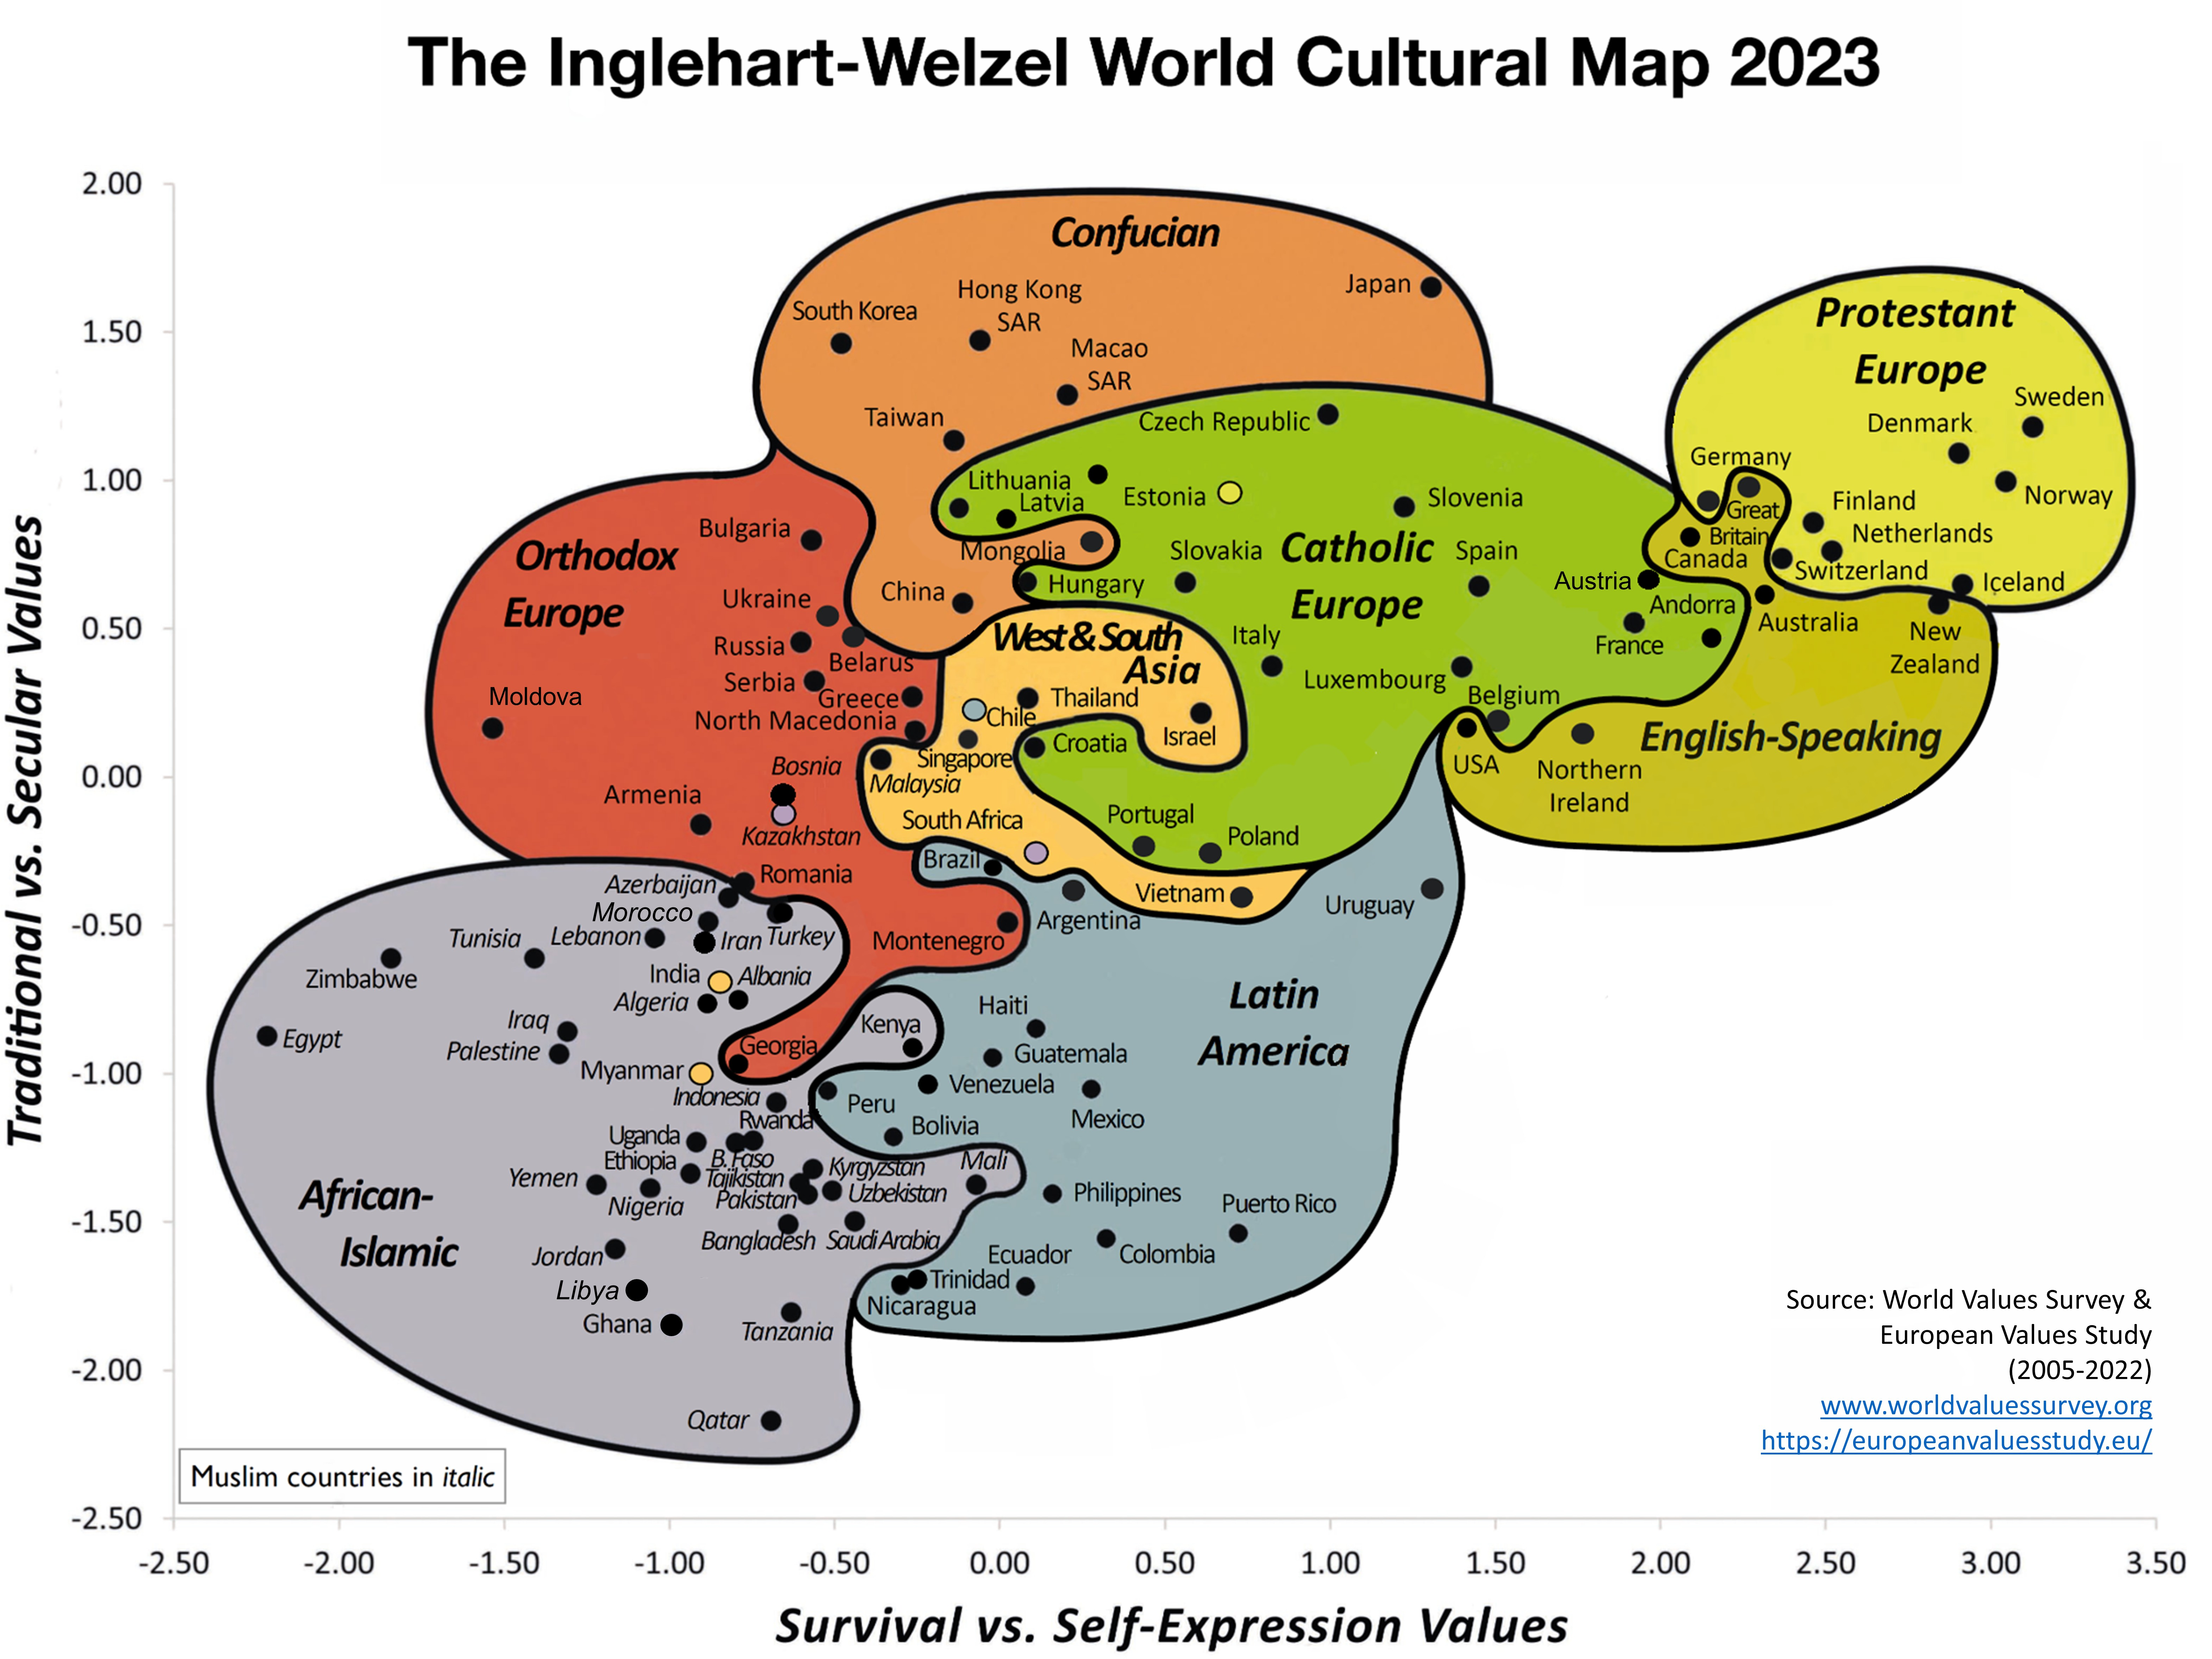

Slide 20
Inglehart and Welzel find that cultures with high levels of traditional or survival values tend to be dictatorships and that cultures with high levels of secular-rational and self-expression values tend to be democracies.
Civic culture: Secular-rational and self-expression values?

Slide 21
Cultural Modernization Theory

Slide 22
Cultural Modernization Theory
Inglehart and Welzel: “socioeconomic development brings roughly predictable cultural changes ... [and] these changes make democracy increasingly likely to emerge where it does not yet exist, and to become stronger and more direct where it already exists.”

Slide 23
Cultural Modernization Theory
Without the necessary cultural changes, democracy is set to fail.
All countries will become democracies once sufficient economic development occurs and brings about the necessary cultural transformation.

Slide 24
Economic development produces predictable cultural changes that help the democratization process.
The industrialization phase sees countries move away from traditional values to secular-rational values.
The post-industrialization phase sees countries move away from survival values to self-expression values.

Slide 25
Industrialization Phase
Pre-Industrial World
Labor-intensive agriculture.
High religiosity.
Low life expectancy and high child mortality.
High fertility and limited life options for women.
Low education.
High deference to authority.
Kinship and tradition.
No resources to engage in political activity.

Slide 26
Industrialization
Growth in science.
Decline in religion.
Bureaucracy and legal systems.
Mass education and increase in human capital.
Reduction in child labor.
Lower fertility rates.
Increasing political activity.

Slide 27
Malthusian Trap.
Previous technological advances had led to immediate increases in living standards.
Over time, though, increases in population size encouraged by the new ‘surplus’ ate away at these higher living standards so that we eventually returned to the same standard of living we had before the technological advance.

Slide 28
Oded Galor: “prior to the Industrial Revolution, people across the world enjoyed largely similar standards of living [at the subsistence level] ... Despite some regional differences, income per capita and wages for unskilled labourers in different civilisations fluctuated within only a very narrow band for thousands of years.”

Slide 29
The industrial revolution marked a break with the Malthusian Trap.
Per capita incomes have increased by a factor of fourteen around the world since the beginning of the 19th century and life expectancy has more than doubled.

Slide 30
The industrial revolution changed the quality-quantity trade-off in family size.
Industrialization brought significantly higher returns to education and human capital.
This brought about the Demographic Transition.

Slide 31
Oded Galor: the “main trend of the past two centuries has been the transition from a world in which most people were illiterate and indigent farmers who toiled incessantly, ate like paupers, and bore large numbers of children only to watch nearly half of them die before reaching adulthood, to one in which most of the world’s population bears children they can expect to outlive them, enjoys varied diets, entertainment and culture, works in a relatively less perilous and strenuous environment, and benefits from significantly higher incomes and longer lives.”

Slide 32
The Demographic Transition brought cultural and political change, especially for women.
Lower fertility rates.
Increase in female paid employment.
Rapid decrease in gender pay gap.
Complete reversal of gender education gap.
Increased demand for female inclusion in the political sphere.

Slide 33
Post-Industrialization Phase
The latter half of the 20th century saw the decline of the industrial sector and the expansion of the service sector in advanced industrialized countries.
This led to a shift away from survival values to self-expression values.

Slide 34
The first couple of decades after World War II saw a prolonged economic boom and rising prosperity.
The rise of the welfare state provided people with a safety net when they fell ill or became unemployed.
With fewer materialist concerns, people could start thinking about how to expand their opportunities for self-expression and individual freedom.

Slide 35
Inglehart: “Silent Revolution”
We see the emergence of new left-libertarian parties such as the Greens in Europe.
A growing sense of human autonomy leads people to question authority, hierarchies, and dogmatism.

Slide 36
Increasing demand for political liberalization, greater emancipation, and a greater say in how political and economic decisions are made.
This puts increased pressure on authoritarian regimes to democratize and for democratic regimes to act more effectively.
This is the story of cultural modernization theory.

Slide 37
But the shift to a post-industrialized society also ushered in other economic, cultural, and political changes that might be viewed less favorably when it comes to the prospects for democracy.

Slide 38
The rising living standards experienced during the Industrial Revolution were in large part the result of the reinforcing effects of rapid technological development and increasing human capital.
While rapid technological development took the form of industrialization, the rise in living standards wasn’t dependent on the process of industrialization itself.
Technological advances and rising living standards didn’t have to come from the industrial sector.

Slide 39
The reinforcing effects of rapid technological development and increasing human capital have continued, but largely in other regions of a country and primarily in high-skilled industries and the service sector.
We’ve seen the collapse of the industrial heartlands and rising inequality across regions and economic sectors.
There’s been significant depopulation in the older industrial areas and a growing sense of disaffection and of being ‘left behind’ among those who remained.

Slide 40
The transition to a post-industrial society has further increased the demand for higher levels of human capital in high-skilled industries and much of the service sector.
This has resulted in more educated societies, with increasing proportions of people going on to higher education.

Slide 41
Significantly, there’s been a strong gendered component to this rise in education.
The gender gap in education that historically favored men has completely reversed and now favors women.
These patterns can be seen in every stage of the education system, and in almost every country in the world.

Slide 42
Many men have found the transition to a post-industrial economy particularly difficult.
There’s been an epidemic of male mortality related to drugs, alcohol, and suicide.
These ‘deaths of despair’ have been concentrated among white men without a college education.

Slide 43
Male grievances with the modernization process have been linked to the success of populist parties on the radical right who use nationalist, sexist, racist, xenophobic, and protectionist messages to explain why they’ve been ‘left behind’ and ‘forgotten’.
The emergence of populist radical right parties can be viewed as a response to the creation of left-libertarian parties in the 1970s.
Many claim that these parties promote policies that encourage democratic backsliding in liberal democracies.

Slide 44
Political competition in post-industrial societies increasingly pits a highly educated, disproportionately female, and ‘progressive’ electorate on the left against a less educated, disproportionately male, and ‘conservative’ electorate on the right.
This division may have contributed to a ‘clash of cultures’ that has fueled right-wing populism and eroded support for democratic institutions.

Slide 45
Visualizing Long-Run Economic and Cultural Change

Slide 46
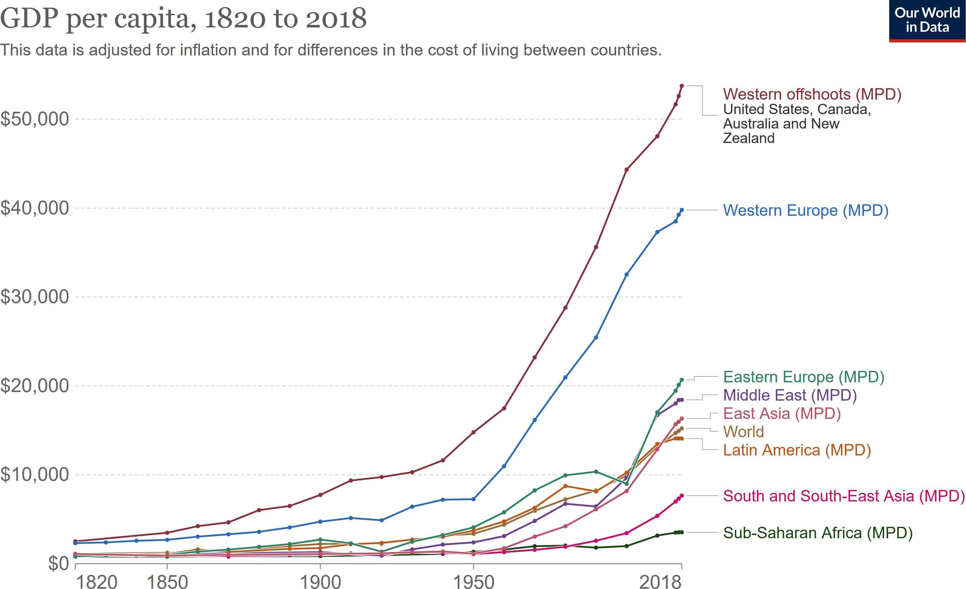

Slide 47
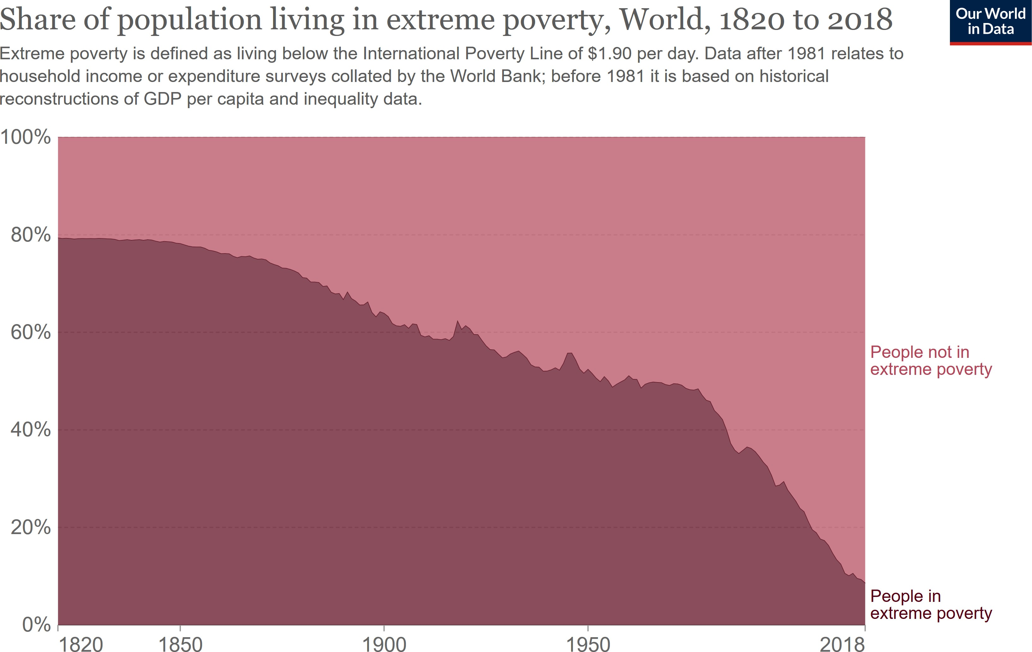

Slide 48
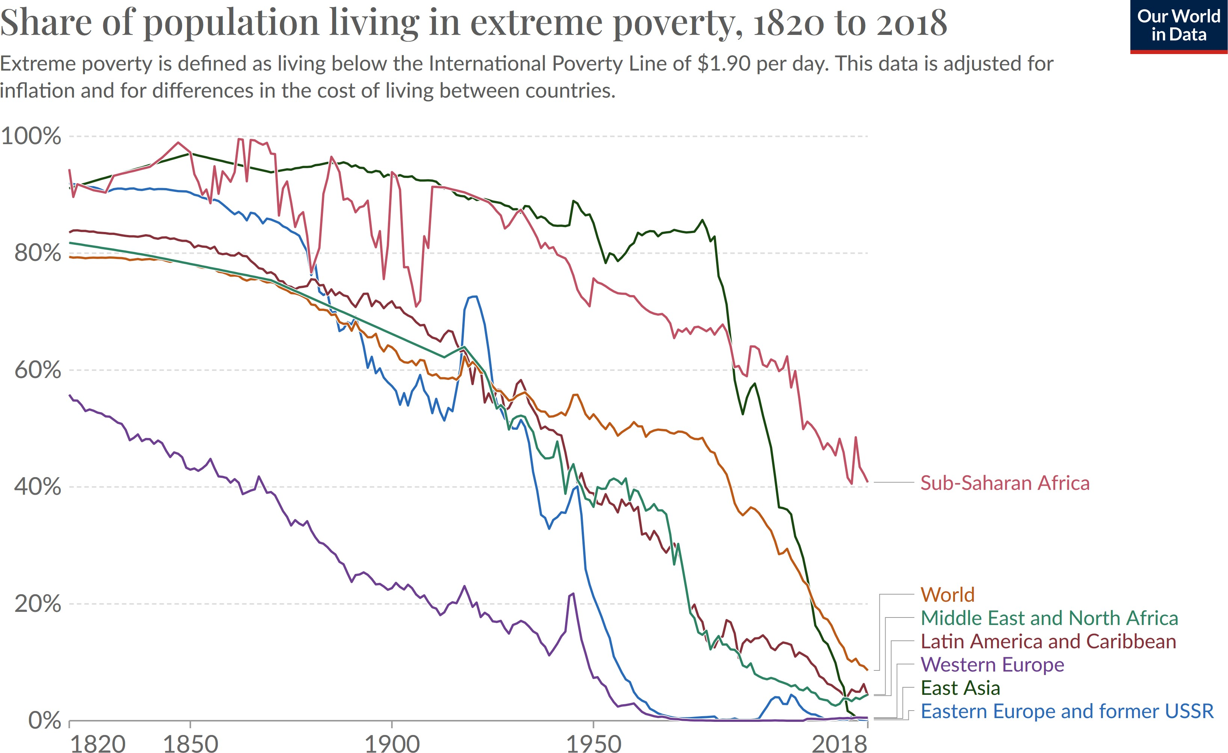

Slide 49
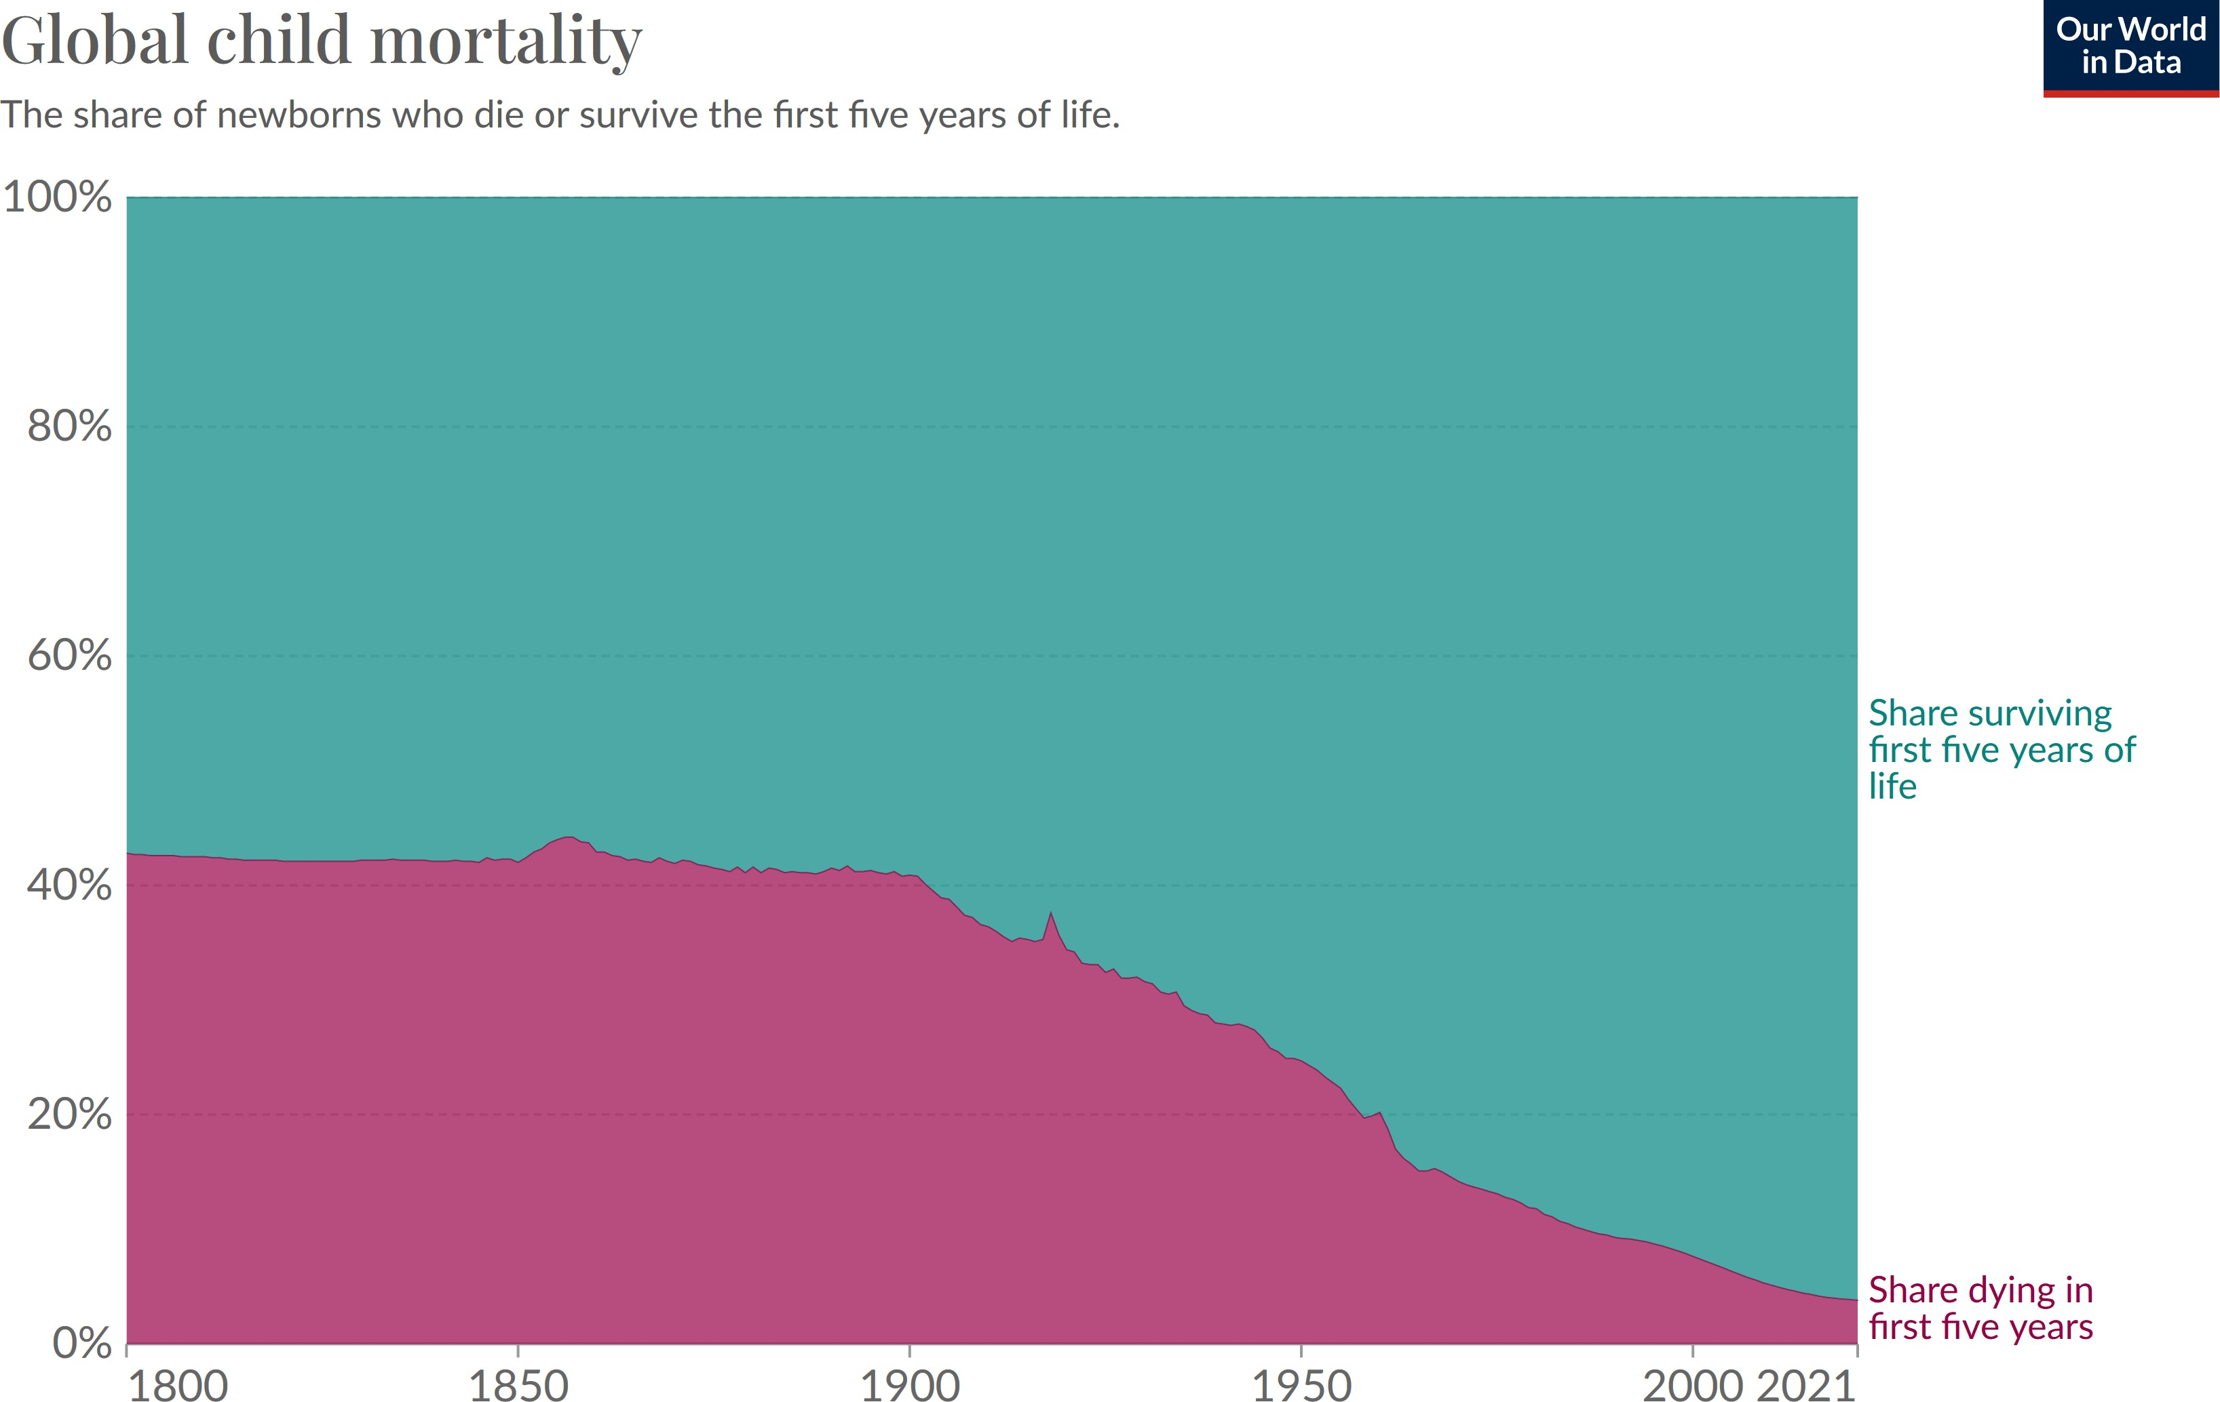

Slide 50
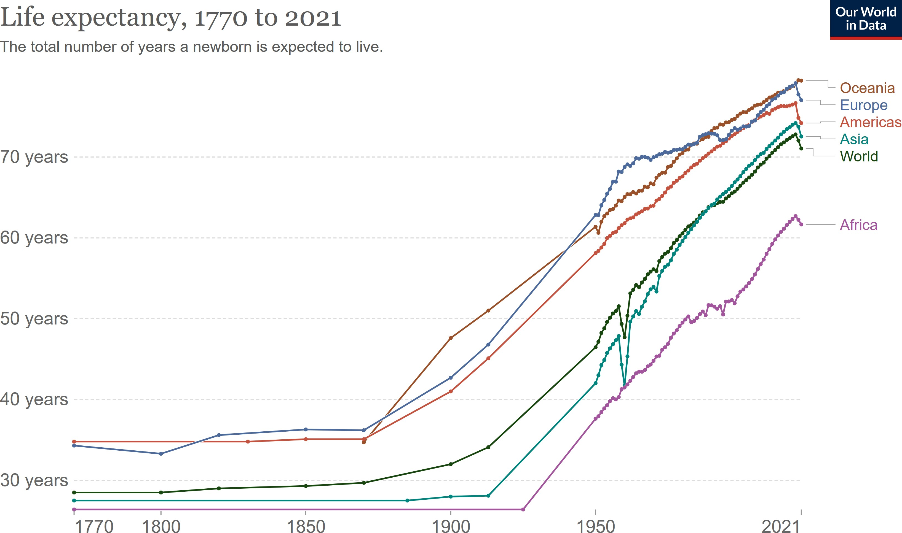

Slide 51
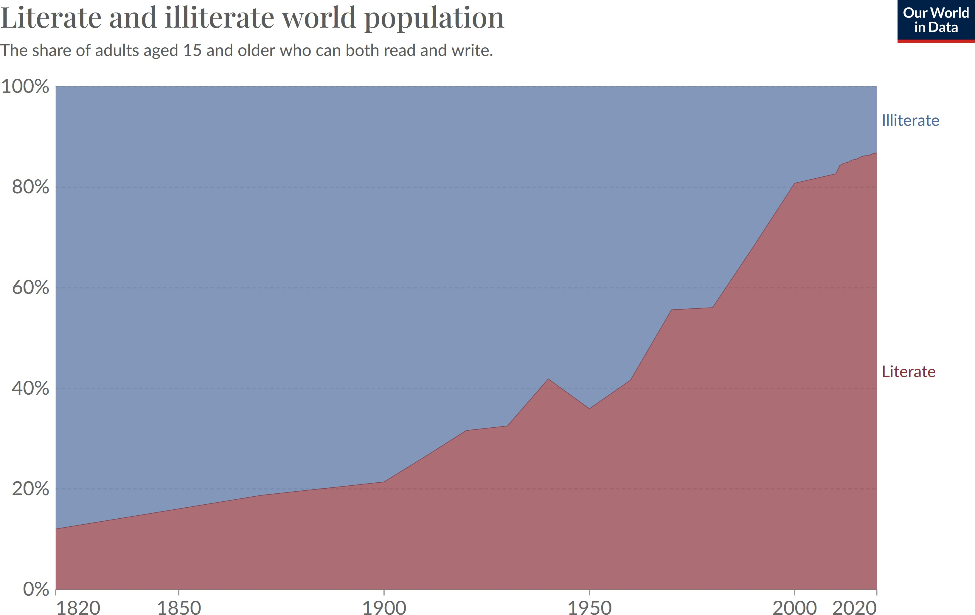

Slide 52
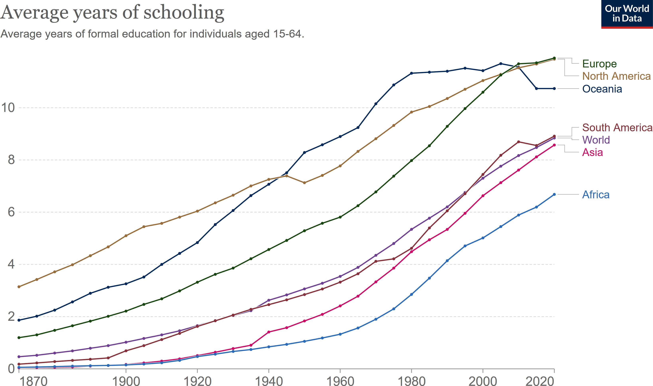

Slide 53
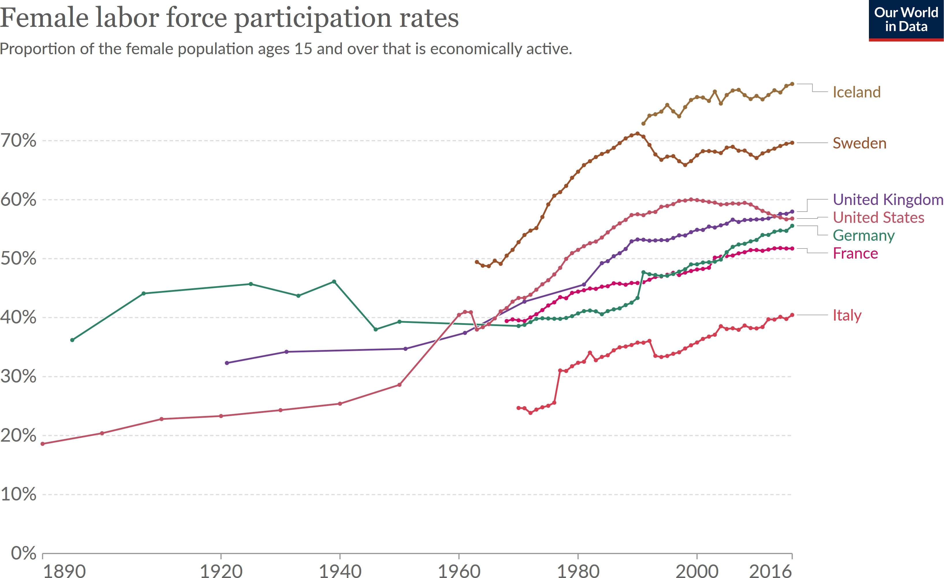

Slide 54
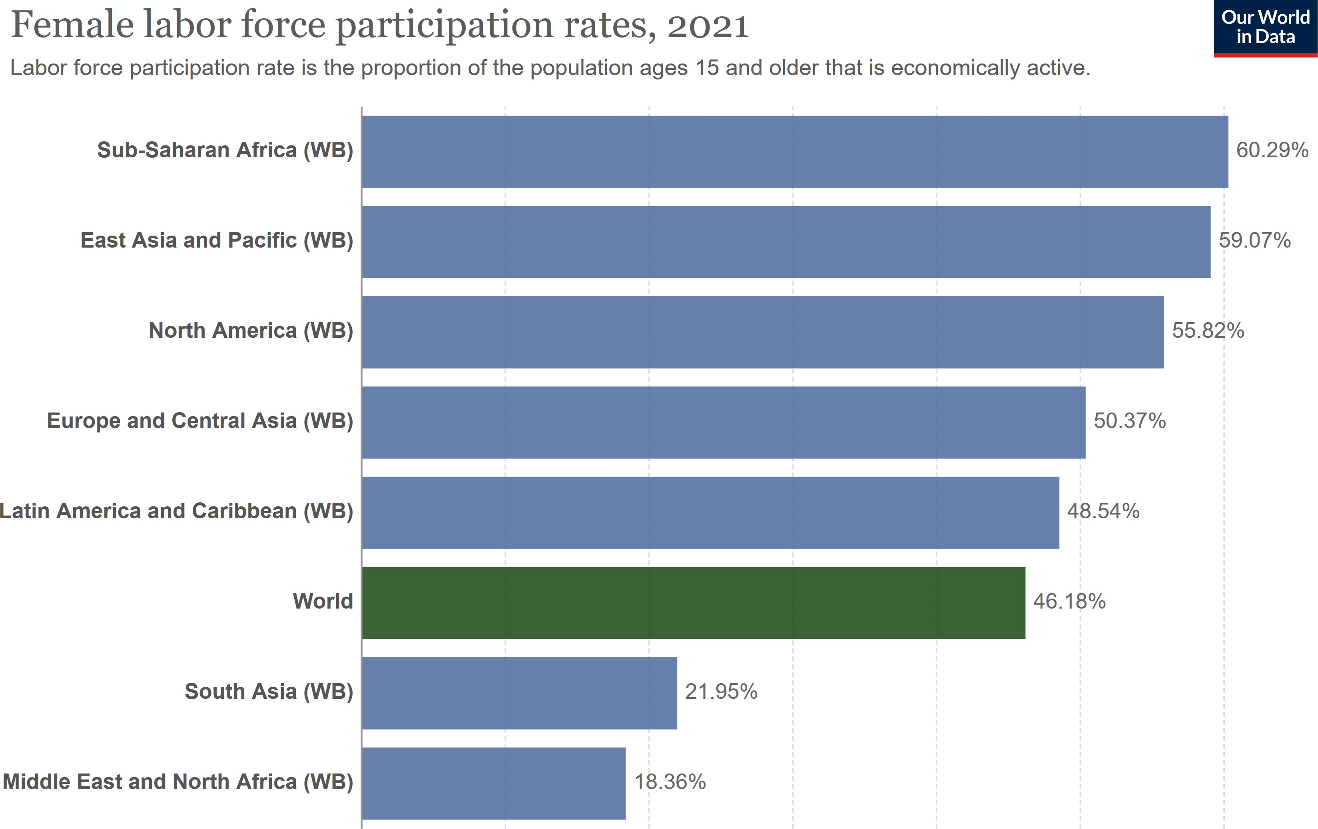

Slide 55
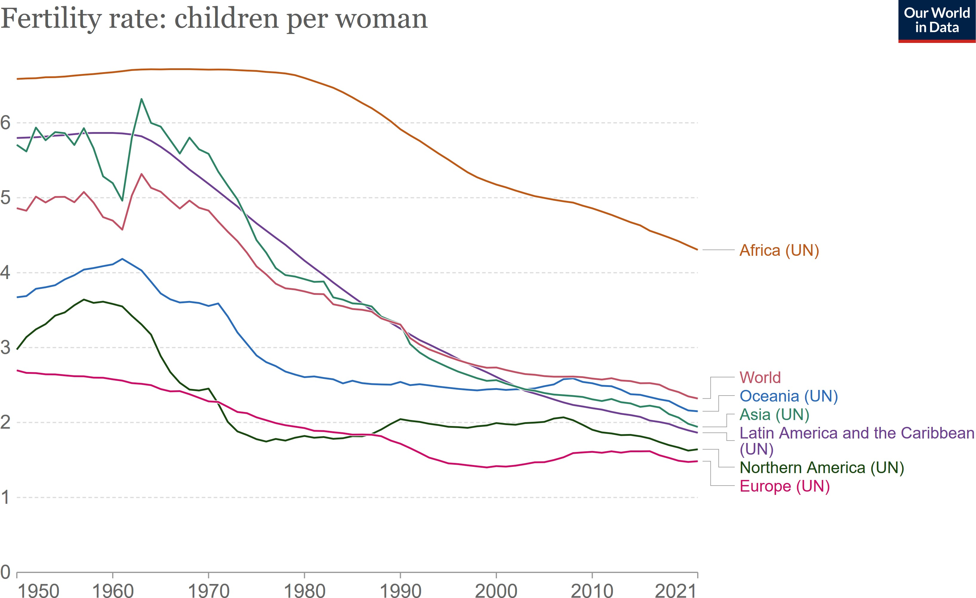

Slide 56
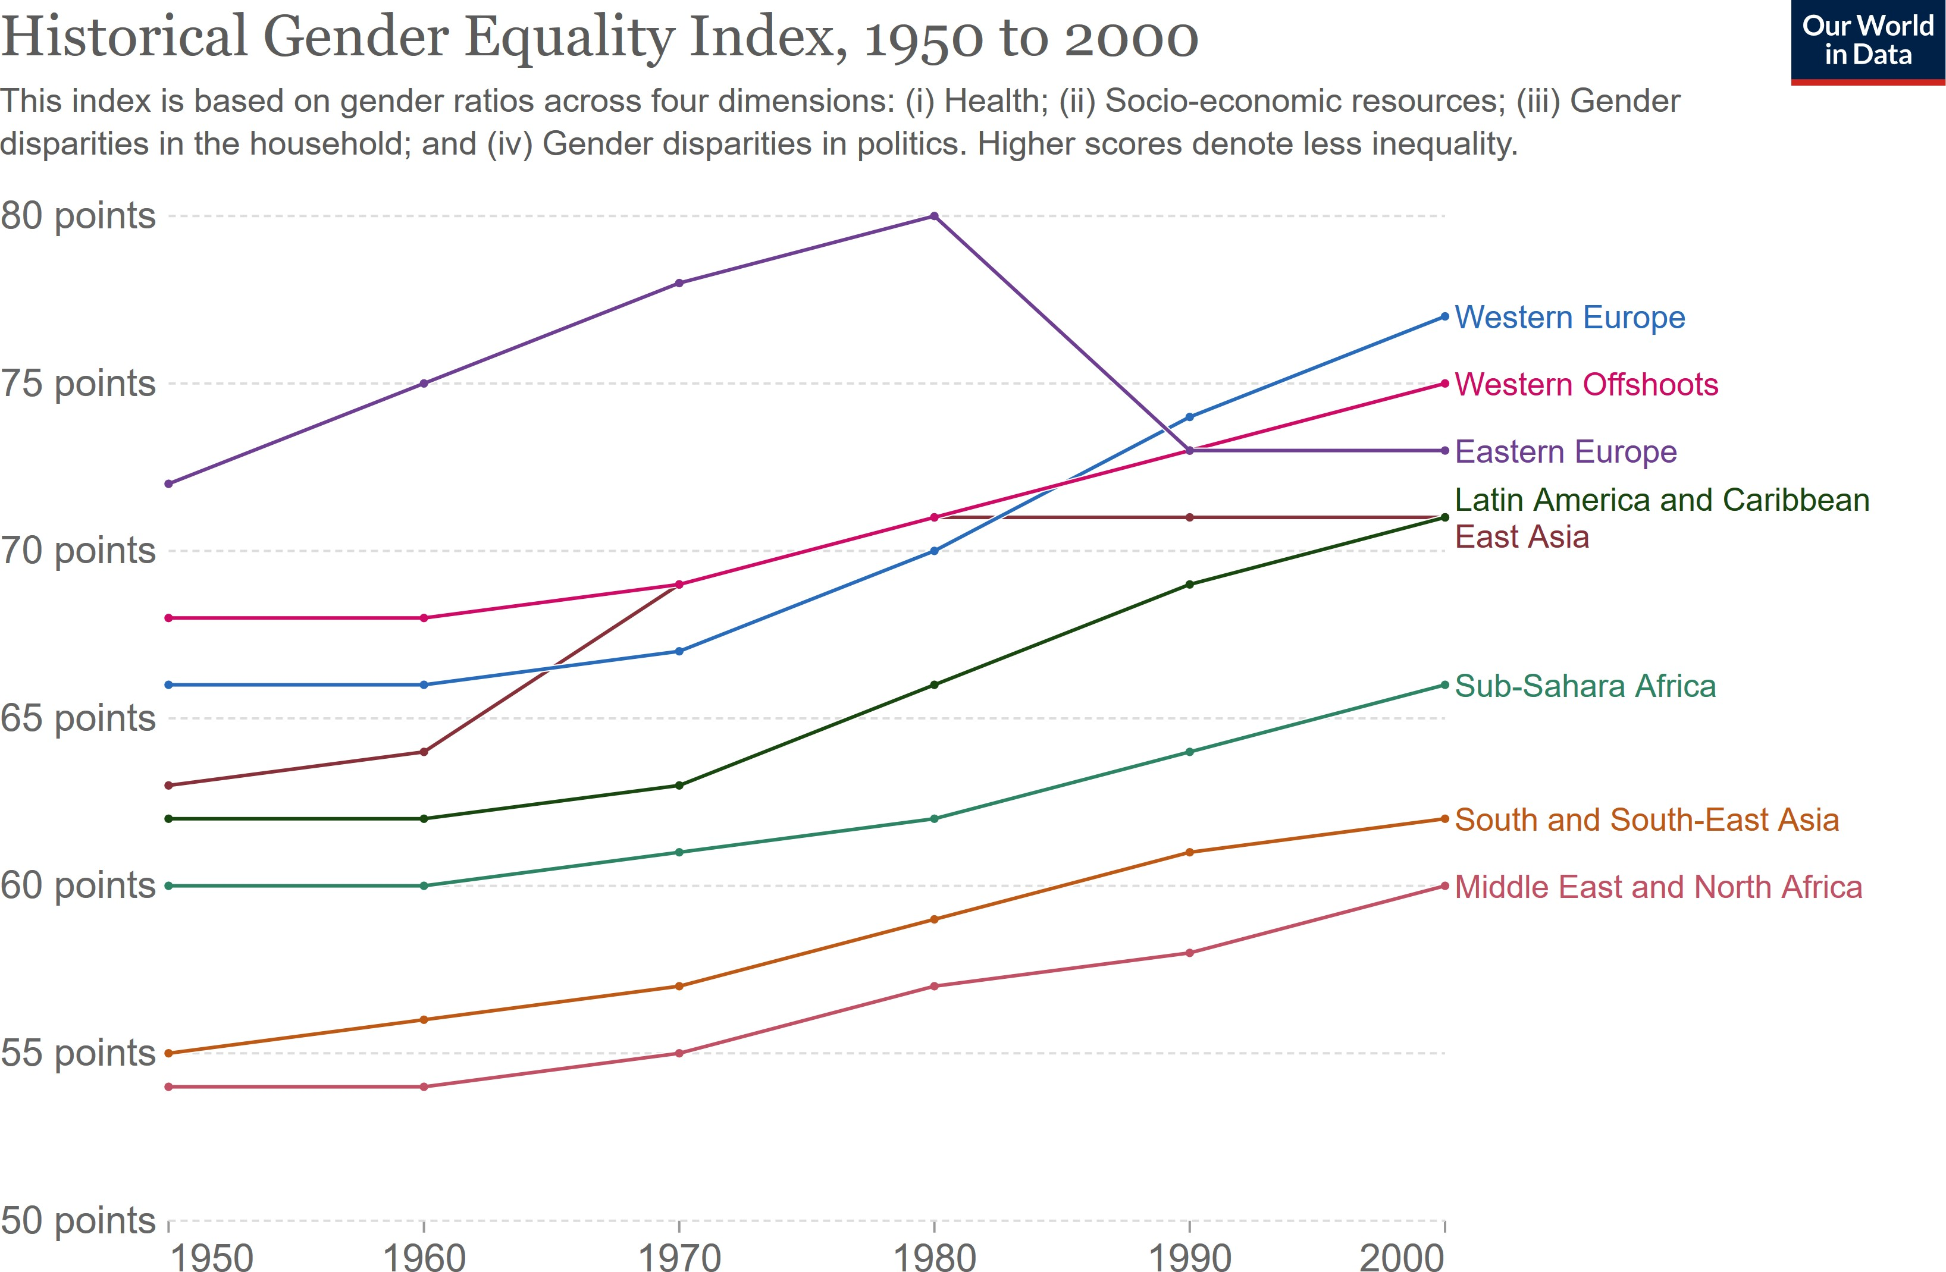

Slide 57
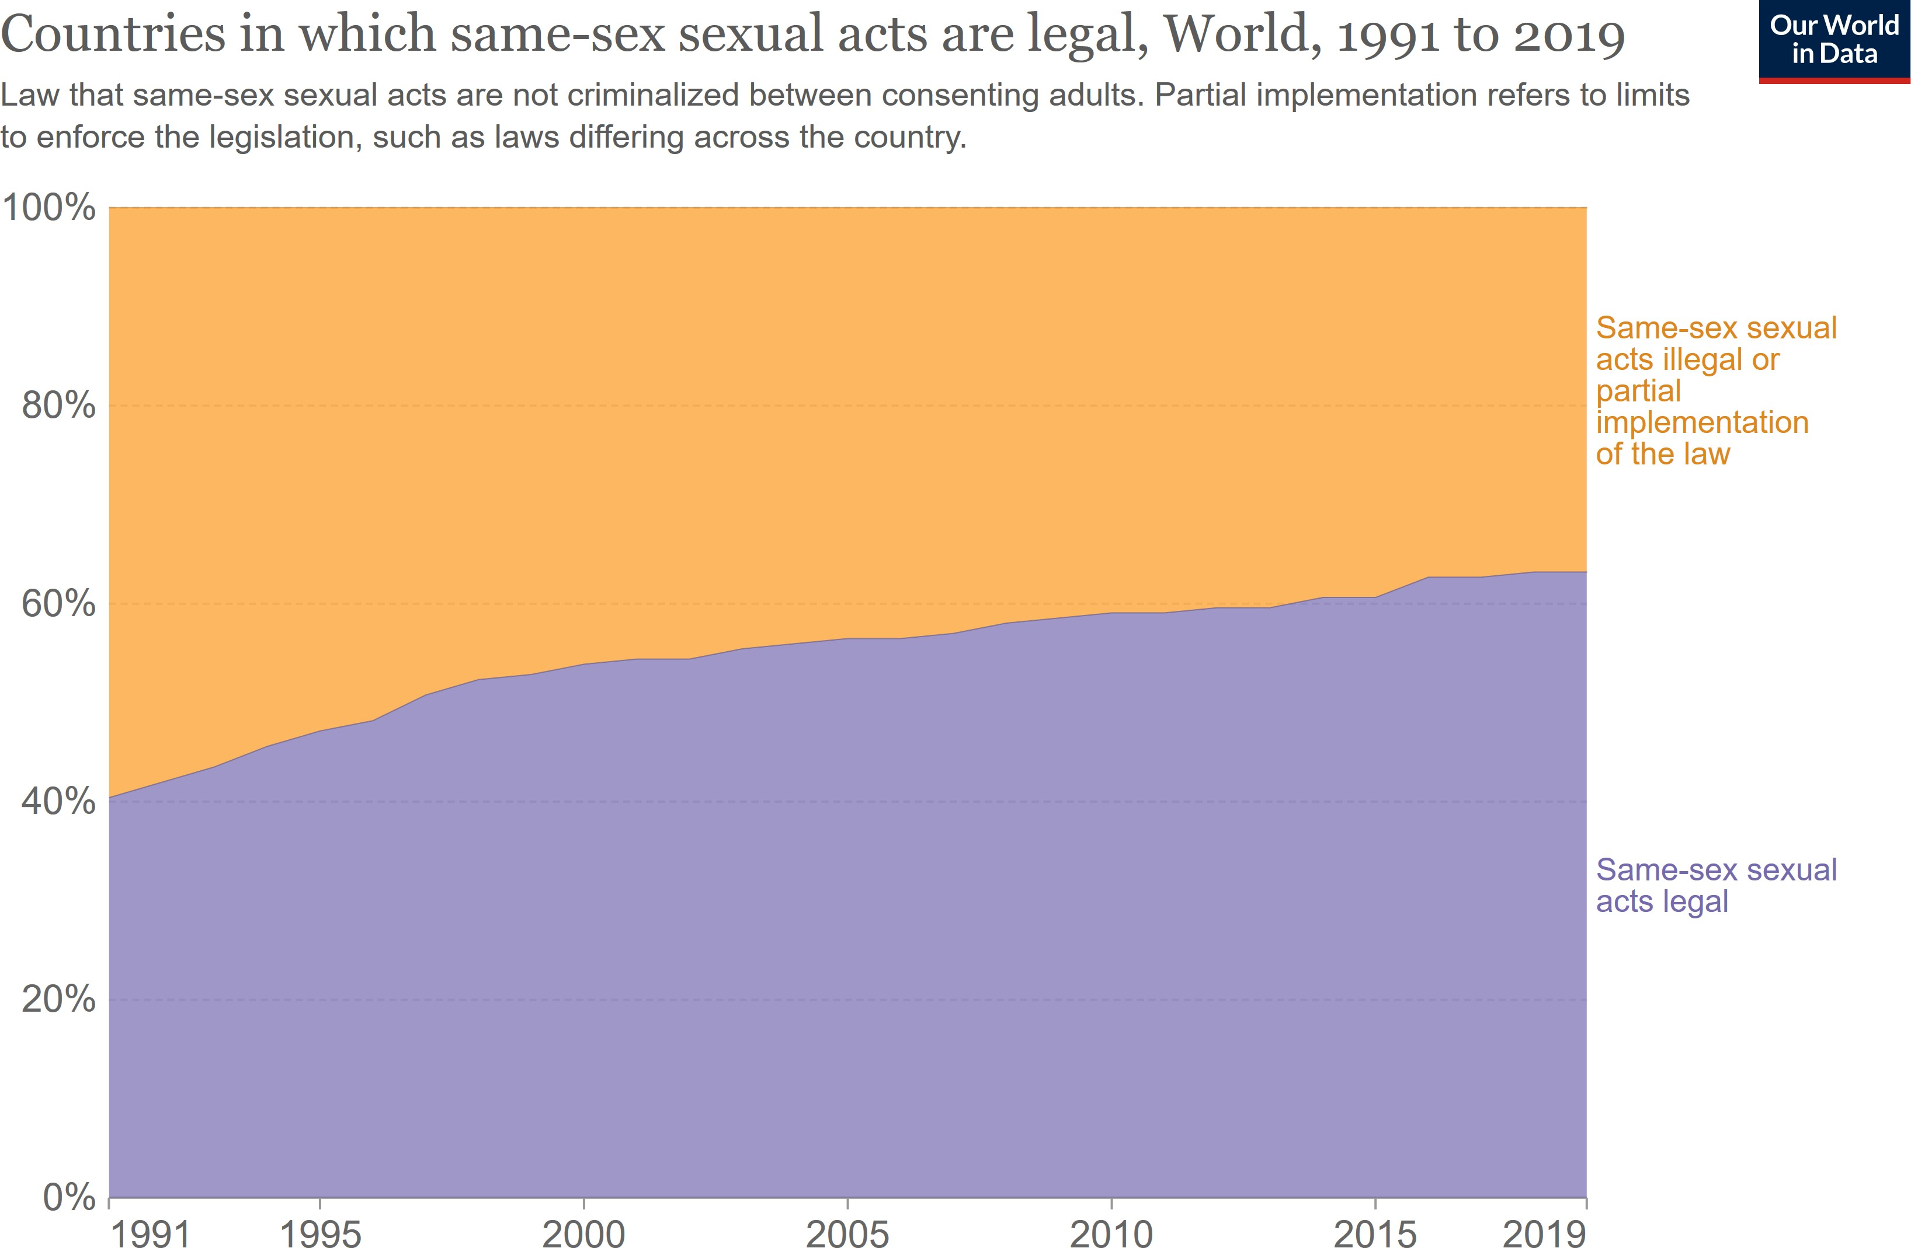

Slide 58
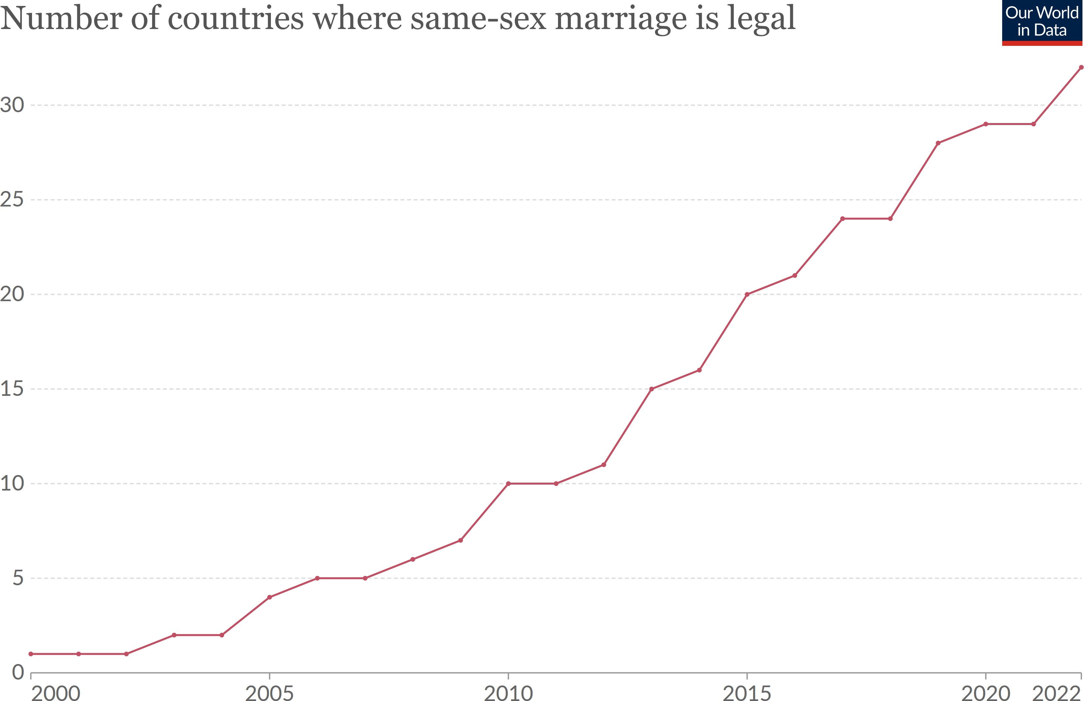

Slide 59
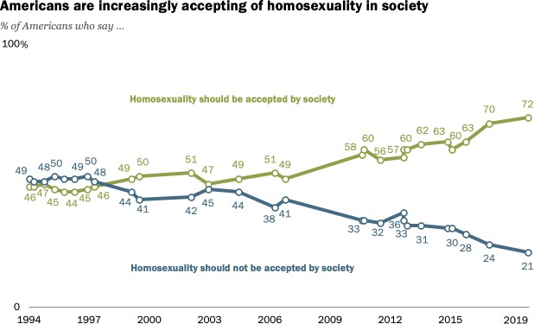

Slide 60
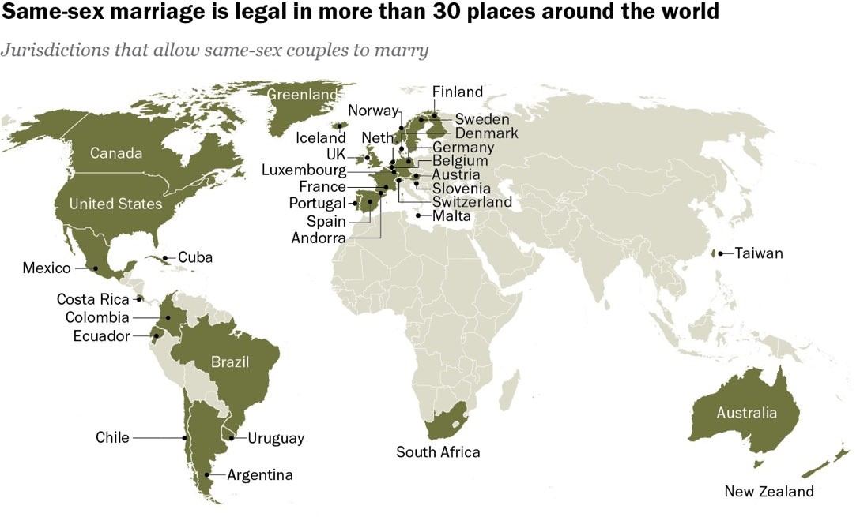

Slide 61
Surveys and Comparative Research

Slide 62
The fact that culture is often conceptualized as a coherent cluster of attitudes, values, and beliefs has led to the widespread use of surveys to examine the relationship between culture and democracy.

Slide 63
“Democracy may have problems, but it’s better than any other form of government. Could you please tell me if you strongly agree, agree, disagree, or strongly disagree?”

Slide 64
When public support for democracy on surveys is low, it’s often seen as a harbinger of democratic instability or collapse.
Recent declines in public support for democracy in developed countries has alarmed many about the possibility of democratic backsliding.

Slide 65
But there’s little empirical evidence to suggest that strong public support is necessary for democracy.
A growing desire to be governed by ‘strong leaders’ or non-partisan ‘experts’ may simply indicate a wish for more competent and effective government; it doesn’t necessarily imply that people don’t want to choose these people or be able to replace them if they fail.

Slide 66
Comparative politics researchers often confront problems when conducting surveys.

Slide 67
Problem 1: Sensitive topics and preference falsification
Social desirability bias refers to the tendency of individuals to overreport ‘good behavior’ and underreport ‘bad behavior.’
Depending on the topic of the survey, there can be strong social incentives to lie or not even participate.

Slide 68
Problem 2: Differential item functioning
Differential item functioning (DIF) exists when individuals or groups understand survey items differently or evaluate survey items using different scales.
This is particularly problematic when we survey people from different regions, countries, or cultures.

Slide 69
Amartya Sen: “the state of Kerala has the highest rates of literacy . . . and longevity . . . in India. But it also has, by a very wide margin, the highest rate of reported morbidity among all Indian states . . . At the other extreme, states with low longevity, with woeful medical and educational facilities, such as Bihar, have the lowest rates of reported morbidity in India. Indeed, the lowness of reported morbidity runs almost fully in the opposite direction to life expectancy, in interstate comparisons . . . In disease by disease comparison, while Kerala has much higher reported morbidity rates than the rest of India, the United States has even higher rates for the same illnesses. If we insist on relying on
self-reported morbidity as the measure, we would have to conclude that the United States is the least healthy in this comparison, followed by Kerala, with ill provided Bihar enjoying the highest level of health. In other words, the most common measure of the health of populations is negatively correlated with actual health.”

Slide 70
Political scientists are increasingly aware of these problems with surveys and have begun to develop ingenious methods to get around them.

Slide 71
Problem 1: Sensitive topics and preference falsification
Potential solutions:
Survey administration
Randomized response techniques
List experiments
Endorsement experiments

Slide 72
Problem 2: Differential item functioning
Potential solutions:
Anchoring vignettes

Slide 73
Are Some Religions Incompatible with Democracy?

Slide 74
Samuel Huntington, The Clash of Civilizations (1993).
Conflicts in the world will be cultural rather than ideological or economic.
“The fault lines between civilizations will be the battle lines of the future.”
Civilizations: Western, Confucian, Japanese, Islamic, Hindu, Slavic-Orthodox, Latin America, Africa.

Slide 75
Huntington argues that the Western belief in the universality of the West’s values and its insistence on imposing those values through democratization efforts will only antagonize other civilizations and lead to conflict.
“Western ideas of individualism, liberalism, constitutionalism, human rights, equality, liberty, the rule of law, democracy, free markets, the separation of church and state, often have little resonance in Islamic, Confucian, Japanese, Hindu, Buddhist, or Orthodox cultures.”

Slide 76
Certain religions are incompatible with democracy.
Islamic and Confucianist countries can’t sustain democracy.
Catholic countries will find it hard to sustain democracy.
Violent conflict will be particularly prevalent between Muslims and non-Muslims.

Slide 77
Some criticisms of the Clash of Civilizations
Monolithic portrayal of civilizations ignores diversity within them.
Extreme form of cultural determinism where the West has always headed towards democracy and other civilizations have always headed towards dictatorship.
Assumes that culture is fixed and unchanging.

Slide 78
Arguments linking religion to democracy have a long history.

Slide 79
Protestantism
Max Weber (1904-1905): Protestantism promotes democracy because of its connection to capitalism and economic development.
Lipset (1959): “Protestantism’s emphasis on individual responsibility furthered the emergence of democratic values.”
Woodberry (2004): The depth and breadth of Protestant missionary activity during colonial periods explains why some countries are democratic.

Slide 80
Catholicism
Huntington: Catholicism is seen as antithetical to democracy.
The emphasis on there being only one church and one truth is seen as incompatible with democracy’s need to accept various different and competing ideologies as legitimate.
The hierarchy in the Catholic church and the distinction between clergy and laity is seen as posing problems for the acceptance of more socially and politically egalitarian institutions such as democracy.

Slide 81
Confucianism
Huntington: Confucian democracy is a contradiction in terms.
Some argued in the Asian Values Debate of the 1990s that Confucianism’s respect for authority and its emphasis on communalism make it incompatible with democracy.

Slide 82
Islam
Huntington: Islam has a violent streak that predisposes Islamic countries to authoritarianism.
Islam is unable to disassociate religious and political spheres.
Islam treats women unequally.

Slide 83
A common thread in these arguments is that there’s something in the doctrines of these religions that make them incompatible with democracy.

Slide 84
A common thread in these arguments is that there’s something in the doctrines of these religions that make them incompatible with democracy.
But, nearly all religions have doctrinal elements that make them seem both compatible and incompatible with democracy.

Slide 85
Confucianism
Confucianism has a tradition of limited government, it recognizes the right of rebellion against rulers who deviate from the prescribed ‘Way’, and it’s religiously tolerant.
The central element of traditional Confucianism concerns one’s personal ethic regulating attitudes towards family, work, education, and everyday life. This personal ethic doesn’t require a specific form of political rule.
Confucian society exists easily in democracies like Japan, South Korea, and Taiwan, in semi-authoritarian regimes like Singapore, and in dictatorships like China and North Korea.

Slide 86
Islam
The basic tenets of Islam have lent themselves to more or less anti-democratic interpretations over time.
Some argue that concepts such as shura (consultation), ijma (consensus of the community), and ijtihad (reinterpretation), and maslaha (public welfare) provide the basis for parliamentary government, elections, and religious reform.

Slide 87
All religions contain doctrinal elements that can be viewed as conducive or detrimental to democracy.
Thus, it becomes an empirical question as to whether certain religions pose difficulties for the emergence and survival of democracy.

Slide 88
Growing evidence that cultures are invented, constructed, and malleable rather than primordial, inherited, and unchanging.
Considerable evidence that the stance of different religions towards political institutions often depends less on religious doctrine and more on the interests of religious and secular leaders, institutional context, and political and economic circumstances.

Slide 89
Catholicism and Democracy
Stathis Kalyvas: The rise of European Christian Democracy in the late 1800s had less to do with Catholic doctrine and more to do with how clerical and conservative secular elites strategically responded to the rise of socialism and liberal anti-clericalism.

Slide 90
Islam and Democracy
Early democracy existed in the first Islamic societies (Constitution of Medina in 622AD).
Early democracy ended with the Islamic conquests in the 7th and 8th centuries as Muslim rulers gained access to the strong state apparatus built by the Sasanian Empire and as their territory expanded.

Slide 91
Islam and Democracy
With the exception of Iran since the 1979 revolution and of Afghanistan during the period of Taliban rule in the 1990s and since 2021, there have been few historical precedents for religious leaders controlling political power in Islamic countries.
Most secular rulers in Islamic countries have governed in an authoritarian way.
Just 8 of over 40 majority-Muslim countries in 2020 were democracies (Albania, Indonesia, Kyrgyzstan, Malaysia, the Maldives, Senegal, Tunisia, and Turkey).

Slide 92
Theorizing about Culture

Slide 93
Traditional Approach
Most studies in political science treat culture as a shared cluster of attitudes, values, and beliefs that exists at the level of some group, such as the nation, region, ethnicity, or religion.
Distinct cultures exhibit a coherent unity that encompasses the most important aspects of a society.

Slide 94
Institutions such as the education system and family help to inculcate and reproduce these unifying attitudes, values, and beliefs at the individual level.
Systems of social control help to deter or rehabilitate deviation from cultural norms. Those that repeatedly violate cultural norms are ‘excluded.’

Slide 95
The result is that cultures are fairly stable and persist over time.
While cultural change is possible, it’s necessarily slow and gradual.
The democratization process can’t be accelerated because the processes of economic modernization and cultural change are necessarily slow.

Slide 96
Alternative Approach
Acemoglu and Robinson: Culture is a repertoire or set of attributes that can be combined in various ways to produce different cultural configurations that give meaning to the world and can be used to justify our political behavior in it.
While the set of attributes available to a culture is assumed to be fixed or slowly changing, cultural configurations are socially constructed and can sometimes change quickly in response to economic and political circumstances.

Slide 97
There tends to be a close association between particular cultural configurations and particular divisions of power.
There’s no sense that economic development is pushing countries to converge on a single cultural configuration that favors democracy.

Slide 98
Culture is a pattern “of beliefs, relationships, rituals, attitudes, and obligations that furnish meaning to human interactions and provide a framework for interpreting the world, coordinating expectations, and enabling or constraining behavior.”
Culture helps to delineate the set of possible actions that are available to us in a given scenario and furnishes us with different ways to justify the actions we take.
Culture provides us with a framework we can use to mobilize others to take the actions we desire.

Slide 99
Attributes include family organization, religious rules, the control of sexual activity, respect for tradition, the role of honor and violence in resolving disputes, the extent of segregation between different types of people, and so on.
Attributes can take on different values. For example, a system of social hierarchy could be based around patriarchy, meritocracy, gerontocracy, or wealth.
Some cultures have more attributes, and hence larger repertoires, than others.

Slide 100
Culture set vs cultural configuration.
Each culture set can give rise to different cultural configurations depending on how its attributes are combined.
Cultural entrepreneurs treat culture as a set of attributes or ‘toolkit’ from which they can pull in order to give their desired meaning to the world and justify their behavior.

Slide 101
To summarize, a culture is a set of attributes and their feasible connections.
A cultural configuration is a particular combination of attributes contained in the culture set.
Cultural norms exist at the level of a cultural configuration. Thus, each culture can support different norms.

Slide 102
Cultural entrepreneurs compete with each other to obtain the cultural configuration and set of norms that gives their most preferred meaning to the world and that best justifies their behavior and desired system of power.
Cultural configurations are, therefore, socially constructed and strategically chosen.

Slide 103
Whereas the culture set associated with a society can change only slowly, cultural configurations can change more quickly if cultural entrepreneurs are able to ‘rewire’ how the existing attributes in the culture set are combined.
This means that we can, in some circumstances, observe rapid cultural change.

Slide 104
The fact that cultural entrepreneurs compete with each other to obtain their desired cultural configuration means that culture is inherently tied up with issues of power and politics.
Acemoglu and Robinson: Societies tend to gravitate towards one of three groups of self-reinforcing political-cultural configurations or ‘social equilibria.’
These three social equilibria are constructed to justify constrained states, unconstrained states, and absent states.

Slide 105
Unconstrained States
The cultural configurations emphasize the legitimacy of top-down rule, how rulers are virtuous or chosen by God, and how political action on the part of the common people is inappropriate.
Rulers push these cultural configurations because they justify and solidify their hold on power. The people also often push these same cultural configurations because they help them better survive life in a dictatorship.
The longer this social equilibrium lasts, the more entrenched these cultural configurations get, and the more stable and legitimate dictatorial rule becomes.

Slide 106
Absent States
The cultural configurations emphasize the danger of political hierarchy, the possibility of predatory rulers, and the value of egalitarian attitudes.
‘Cage of norms’ with strict systems of social stratification that differentiate people into a hierarchy of competing groups.
The absence of the state comes to be seen as natural and legitimate, and people are highly skeptical of efforts to build state capacity.

Slide 107
Constrained States
Three features:
The people are suspicious of those who are politically powerful and so regularly participate in civil society organizations and other institutionalized forms of political participation to hold rulers accountable.
A high degree of trust towards one another and towards state institutions such as courts, bureaucracies, and security forces.
A model of political philosophy that emphasizes how political power ultimately comes from the people.

Slide 108
The prevailing cultural configuration in a country at any point in time depends on the attributes in its culture set and their feasible connections.
The back-and-forth interaction between culture and politics means that it also depends on the balance of power between the state and society.
History and cultural entrepreneurs whose job it is to ‘construct’ or ‘invent’ cultural configurations also matter.

Slide 109
The three political-cultural social equilibria are self-reinforcing.
However, a change in a political-cultural social equilibrium can sometimes ocurr, and is often precipitated by a change in the balance of power between the state and society.

Slide 110
Up to now, we’ve assumed that shifts in the balance of power translate seamlessly into new or reformed political institutions that better reflect the new distribution of power.
However, the successful establishment of a new political system depends on our ability to construct a revised cultural configuration that can justify it and provide it with legitimacy.
If we can’t construct such a cultural configuration or if such a cultural configuration fails to win enough adherents, then the new political arrangements won’t be viewed as legitimate and will therefore be unstable.

Slide 111
This means that cultural entrepreneurs necessarily play an important role in bringing about political change.
Philosophers such as Hobbes and Locke were important for the success of the Glorious Revolution.
They popularized a new cultural configuration based around ‘popular sovereignty’ as an alternative to the prevailing hierarchical configuration of absolutist rule and the divine right of kings.

Slide 112
The ability of cultural entrepreneurs to construct alternative cultural configurations to justify new political systems depends on the ‘fluidity’ of a culture.
Cultures are more fluid if they’re able to produce a larger set of cultural configurations.
This depends on both the number and type of attributes in a culture set.

Slide 113
Cultures that lack fluidity and which are more ‘hard-wired’ won’t change much over time. This will give the impression that they’ve been fixed since ‘primordial’ times.
In contrast, fluid cultures have the potential to exhibit change. They provide cultural entrepreneurs with more ‘tools’ to construct a cultural configuration that can support their desired political system.
Political change is easier when we’re dealing with a fluid culture.

Slide 114
This provides a theoretical basis for the idea that some cultures are more or less compatible with democracy than others.
It also adds culture as another condition for modernization theory’s claim that economic development leads to democracy.
Economic development without the right cultural conditions may not produce stable democracy even if other conditions are satisfied.

