Slide 1
Democratic Transitions

Slide 2
Independent Countries, Democracies, and Dictatorships, 1946-2020
200
160
Number of Countries
120
80
40
Democracies Dictatorships Independent Countries
2010 2020
0
1950
1960
1970
1980 1990
Year
2000

Slide 3
Huntington: Three Waves of Democracy
1828-1926: American and French revolutions, WWI.
1943-1962: Italy, West Germany, Japan, Austria etc.
1974-: Greece, Spain, Portugal, Latin America, Africa etc.

Slide 4
A bottom-up transition is one in which the people rise up to overthrow an authoritarian regime in a popular revolution.
A top-down transition is one in which the dictatorial ruling elite introduces liberalizing reforms that ultimately lead to a democratic transition.

Slide 5
Bottom-up Transitions

Slide 6
East Germany
Mass protests in 1989 forced the East German government to open up the Berlin Wall and allow free elections.
The end result was German reunification.
From our vantage point, the collapse of communism in Eastern Europe is seen as inevitable.

Slide 7
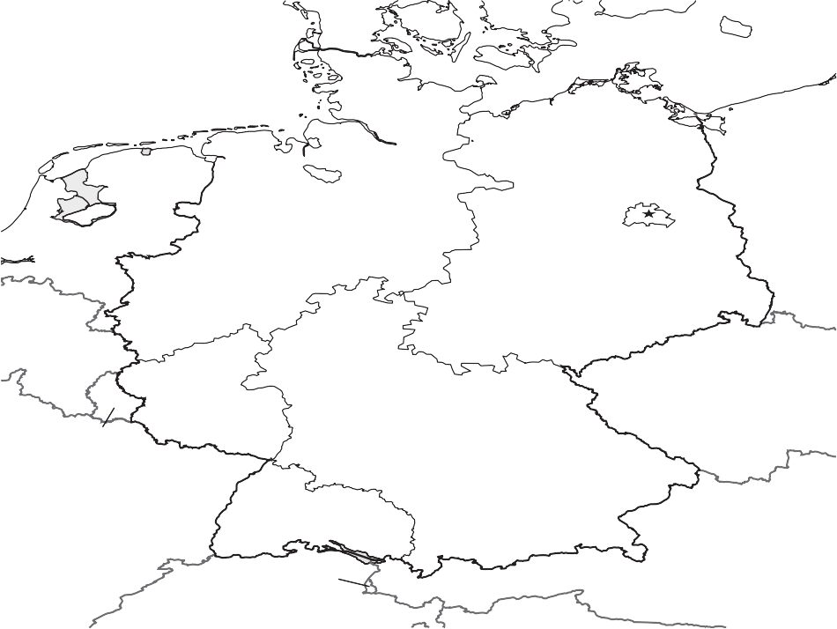
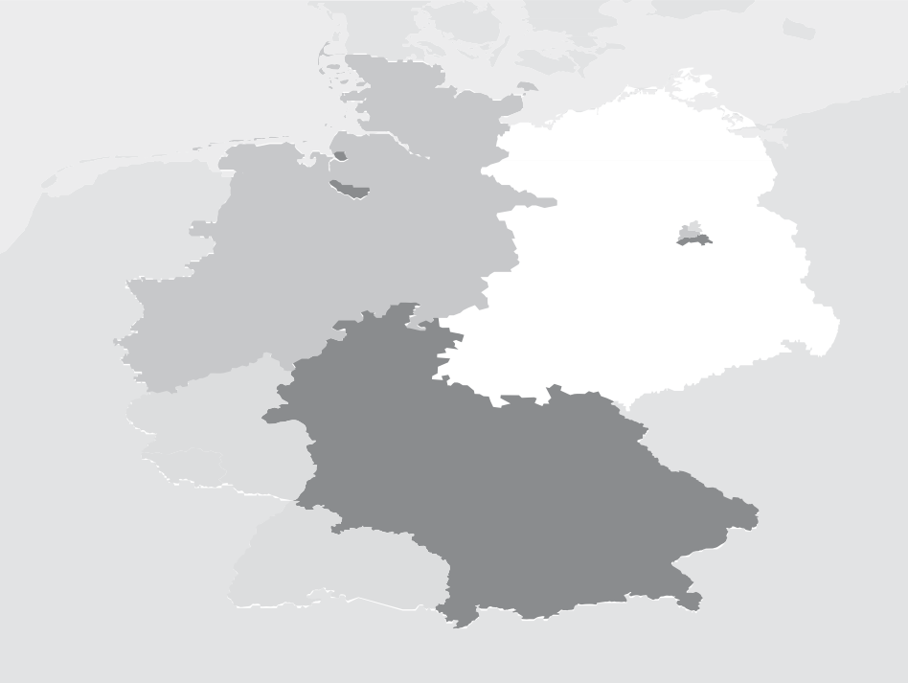
D E N M A R K
SWEDEN
Baltic Sea
North Sea
Hamburg
NETHERLANDS
Bremen
POLAND
Hannover
Berlin
G E R M A N Y
Düsseldorf Cologne
Bonn
Dresden
BELGIUM
Frankfurt
CZECHOSLOVAKIA
LUXEMBOURG
Saarbrücken
Nürnberg
Stuttgart
FRANCE
Munich
United States
United Kingdom France
Soviet Union
AUSTRIA
LIECHTENSTEIN
0
75 Mi
SWITZERLAND
0
75 Km

Slide 8
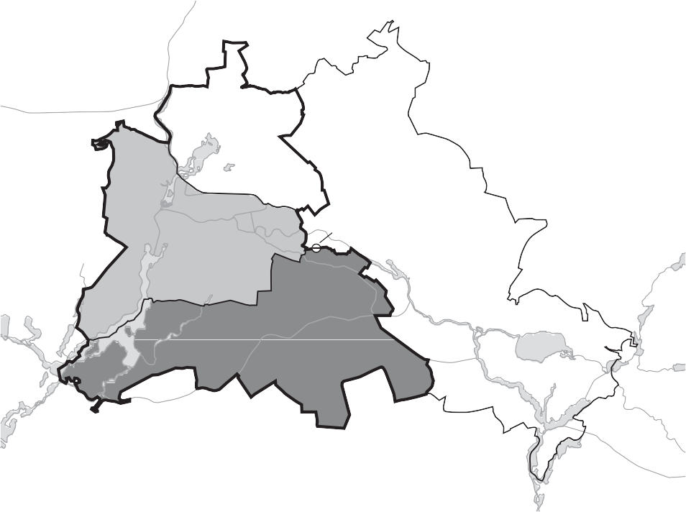
Bernau
Berlin Wall
American sector British sector French sector Soviet sector
Hennigsdorf
Falkensee
WES T
BERLIN
E AS T
Checkpoint
Neuenhagen
Charlie
BERLIN
Potsdam
EA S T
GERMANY
0
3 Mi
0
3 Km

Slide 9
At the time, the collapse of communism came as a complete surprise to almost everyone.
Communist regimes, and particularly East Germany, seemed very stable.

Slide 10
Mikhail Gorbachev 1985
Perestroika (economic restructuring) was a reform policy aimed at liberalizing and regenerating the Soviet economy.
Glasnost (openness) was a reform policy aimed at increasing political openness.

Slide 11
Events in 1989
Solidarity and Roundtable Talks in Poland.
Hungary liberalized and opened its borders to the West.
Neues Forum: “Wir bleiben hier” and “Wir sind das Volk.”

Slide 12
Berlin Wall
Berlin Wall I, click here (5:56)
Berlin Wall II, click here (3:44)
Wind of Change, click here (7:36)
Notes:
PONER VIDEOS

Slide 13
Bottom-up transitions
People Power Revolution in the Philippines, 1986.
June Resistance in South Korea, 1987.
Velvet Revolution in Czechoslovakia, 1989.
Orange Revolution in the Ukraine, 2006.
Jasmine Revolution in Tunisia, 2011.

Slide 14
Tiananmen Square, China, June 1989
2017 Tiananmen Square Documentary, click here (23:02)
BBC News, June 4, 1989, click here (3:34)
2017 Frontline Documentary, click here (1:24:23)

Slide 15
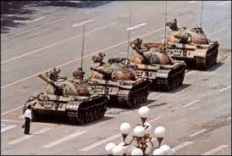
In 2015, only 15 out of 100 students at Beijing University were able to recognize this photo.

Slide 16
How can we explain these bottom-up transitions?
Why are revolutions so rare and hard to predict?
Why do dictatorship regimes seem so fragile after the fact but so stable beforehand?

Slide 17
Collective Action Theory

Slide 18
Collective action refers to the pursuit of some objective by groups of individuals. Typically, the objective is some form of public good.

Slide 19
A public good is nonexcludable and nonrivalrous.
Nonexcludability means that you can’t exclude people from enjoying the public good.
Nonrivalry means that there’s just as much public good for people to enjoy no matter how many people consume it.
Examples: Lighthouse, fire station, national park, democracy.

Slide 20
Public goods are often quite desirable.
You might expect that groups of individuals with common interests would act collectively to achieve those interests.

Slide 21
The collective action, or free-rider, problem refers to the fact that individual members of a group often have little incentive to contribute to the provision of a public good that will benefit all members of the group.

Slide 22
Imagine a group of N individuals.
If K people contribute or participate, the public good is provided. The value of the public good to each individual is B.
The cost of contributing or participating is C. Let’s assume that B > C.

Slide 23
Pro-Democracy Protest: Do I Participate or Not?
 | Scenario 1 | Scenario 2 | Scenario 3
 | (Fewer than K − 1 participate) | (Exactly K − 1 participate) | (K or more participate)
Participate | - C | B − C | B − C
Don’t participate | 0 | 0 | B
Note: K = the number of individuals that must participate for the pro-democracy protest to be successful; C = cost associated with participating; B = benefit associated with a successful pro-democracy protest; underlined letters indicate the payoffs associated with the actor’s best response—participate or don’t participate—in each scenario. It’s assumed that B − C > 0.

Slide 24
The likelihood of successful collective action depends on the costs of participation and the size of the benefit.
Successful collective action is more likely when C goes down.
Successful collective action is more likely when B goes up.

Slide 25
The likelihood of successful collective action also depends on:
The difference between K and N.
The size of N.
This is because of their effects on the incentive to free ride.

Slide 26
The difference between K and N.
If K = N , then there’s no incentive to free-ride.
If K < N , then there’s an incentive to free-ride.
The larger the difference between K and N , the greater the incentive to free-ride.
Successful collective action is more likely when the difference between K and N is small.

Slide 27
The size of N.
The size of N influences the likelihood that you’ll think of yourself as critical to the collective action.
The larger the group, the harder it is to monitor, identify, and punish free-riders.
Successful collective action is more likely when N is small.
This leads to the counter-intuitive result that smaller groups may be more powerful than larger groups.

Slide 28
Collective action theory provides an explanation for the apparent stability of communism in Eastern Europe and for why public demonstrations in dictatorships are so rare.
Although many people under dictatorship share a common interest in the regime’s overthrow, this doesn’t automatically mean they’ll take collective action to achieve this.

Slide 29
Collective action theory provides an explanation for the apparent stability of communism in Eastern Europe and for why public demonstrations in dictatorships are so rare.
Although many people under dictatorship share a common interest in the regime’s overthrow, this doesn’t automatically mean they’ll take collective action to achieve this.
Participation in collective action now becomes the puzzle we need to explain.

Slide 30
Tipping Models

Slide 31
Tipping models provide an explanation for the mass protests that occurred in Eastern Europe in 1989.

Slide 32
An individual must choose whether to publicly support or oppose the dictatorship.
They have a private and a public preference regarding the dictatorship.
Preference falsification: Because it’s dangerous to reveal your opposition to a dictatorship, individuals who oppose the regime often falsify their preferences in public.

Slide 33
There’s often a protest size at which individuals are willing to publicly reveal their true preferences.
As protests become larger, it becomes harder for dictatorships to monitor and punish each individual.
A revolutionary threshold is the size of protest at which an individual is willing to participate.

Slide 34
Individuals naturally have different revolutionary thresholds.
Some people with low thresholds are happy to oppose the government irrespective of what others do.
Some people with higher thresholds will protest only if lots of others do.
Some people with very high thresholds actually support the regime and are extremely unwilling to protest.

Slide 35
The distribution of revolutionary thresholds is crucial in determining whether a revolution occurs or not.
Society A = {0, 2, 2, 3, 4, 5, 6, 7, 8, 10}

Slide 36
The distribution of revolutionary thresholds is crucial in determining whether a revolution occurs or not.
Society A = {0, 2, 2, 3, 4, 5, 6, 7, 8, 10}
Only one person will protest.

Slide 37
The distribution of revolutionary thresholds is crucial in determining whether a revolution occurs or not.
Society A = {0, 2, 2, 3, 4, 5, 6, 7, 8, 10}
Only one person will protest.
Society A’ = {0, 1, 2, 3, 4, 5, 6, 7, 8, 10}

Slide 38
The distribution of revolutionary thresholds is crucial in determining whether a revolution occurs or not.
Society A = {0, 2, 2, 3, 4, 5, 6, 7, 8, 10}
Only one person will protest.
Society A’ = {0, 1, 2, 3, 4, 5, 6, 7, 8, 10}
Nine people protest.

Slide 39
A revolutionary cascade is when one person’s participation triggers the participation of another, which triggers the participation of another, and so on.

Slide 40
Society A = {0, 2, 2, 3, 4, 5, 6, 7, 8, 10}
Society A’ = {0, 1, 2, 3, 4, 5, 6, 7, 8, 10}
Nine person revolt and revolutionary cascade.

Slide 41
Society B = {0, 2, 3, 3, 4, 5, 6, 7, 8, 10}
Society B’ = {0, 1, 3, 3, 4, 5, 6, 7, 8, 10}
Two person revolt and no revolutionary cascade.

Slide 42
The same change in revolutionary thresholds may lead to a revolution in one setting but to a small, abortive, and ultimately unsuccessful protest in another.
Economic recessions and deprivation may cause private preferences and revolutionary thresholds to move against the regime without actually causing a revolution.
Structural factors aren’t sufficient to produce revolutions, although they can make revolutions more likely by shifting the distribution of revolutionary thresholds.

Slide 43
Preference falsification means that a society’s distribution of revolutionary thresholds is never known to outsiders or even the individuals in that society.
Thus, a society can come to the brink of a revolution without anyone knowing.

Slide 44
Our inability to observe private preferences and revolutionary thresholds conceals potential revolutionary cascades and makes revolutions impossible to predict.
Timur Kuran: “predictability of unpredictability”

Slide 45
Structural changes in the 1980s lowered the revolutionary thresholds of East Europeans.
Appointment of Gorbachev.
Poor economic performance in Eastern Europe.
Statement that the Soviet Union would not intervene militarily in the domestic politics of Eastern Europe.

Slide 46
Demonstration effects and revolutionary diffusion.
The successful introduction of pro-democracy reforms in one country reduced revolutionary thresholds elsewhere.
This led to a revolutionary cascade across countries rather than simply across individuals within countries.
“Poland – 10 years, Hungary – 10 months, East Germany – 10 weeks, Czechoslovakia – 10 days.”

Slide 47
Why did the collapse of communism seem so inevitable in hindsight?
Historians who interviewed individuals across Eastern Europe report that there was a huge pent-up pool of opposition to Communist rule that was bound to break at some point.

Slide 48
Preference falsification works both ways!
As a revolutionary cascade starts to snowball, supporters of the Communist regime may feel obliged to join the pro-democracy protests.
Just as pro-democracy supporters falsify their preferences under dictatorship to avoid punishment, pro-dictatorship supporters falsify their preferences under democracy.
Revolutions will always appear inevitable in hindsight.

Slide 49
Top-down Transitions

Slide 50
A top-down transition is one in which the dictatorial ruling elite introduces liberalizing reforms that ultimately lead to a democratic transition.
A policy of liberalization entails a controlled opening of the political space and might include the formation of political parties, holding elections, establishing a judiciary, opening a legislature, and so on.

Slide 51
The period of liberalization often results from a split in the authoritarian regime between hard-liners and soft-liners.
This split is often caused by declining economic conditions or social unrest.

Slide 52
The hard-liners are satisfied with the status quo, but the soft-liners prefer to liberalize and broaden the social base of the dictatorship.
The soft-liners must decide whether to stick with the status quo or liberalize.

Slide 53
Transition Game without Payoffs
Soft-liners
Do Nothing
Open
Opposition
O1: Status quo
Enter
Or g anize
Soft-liners
O2: Broadened dictatorship
Repress
Democr atize
O3: Narrow dictatorship or
O4: Insurgency
O5: Democratic transition

Slide 54
Turning Outcomes into Payoffs in Transition Game
Outcome | Description | Soft-liners | Opposition
O1 | Status quo | 4 | 3
O2 | Broadened dictatorship | 5 | 4
O3 | Narrow dictatorship | 3 | 1
O4 | Insurgency | 1 | 2
O5 | Democratic transition | 2 | 5

Slide 55
Transition Game with Payoffs
(a) Weak Opposition
(b) Strong Opposition
Soft-liners
Soft-liners
Do Nothing
Open
Do Nothing
Open
Opposition
Opposition
Status quo (4,3)
Status quo (4,3)
Enter
Or g anize
Enter
Or g anize
Soft-liners
Soft-liners
Broadened dictatorship (5,4)
Broadened dictatorship (5,4)
Repress
Democratize
Repress
Democratize
Narrow dictatorship (3,1)
Democratic transition (2,5)
Insurgency (1,2)
Democratic transition (2,5)
The subgame perfect equilibrium is (Open, Repress; Enter).
The subgame perfect equilibrium is (Do Nothing, Democratize; Organize).

Slide 56
Two possible outcomes
If the opposition is strong, we have the status quo.
If the opposition is weak, we have a broadened dictatorship.
A transition to democracy is not possible.

Slide 57
A complete information game is one in which each player knows all the information there is to know about the game.

Slide 58
A complete information game is one in which each player knows all the information there is to know about the game.
But what happens if the soft-liners don’t know whether the opposition is weak or strong?

Slide 59
Democratic transitions are possible if the soft-liners think the opposition are weak but the opposition is, in fact, strong.
Top-down democratic transitions can only happen if someone makes a mistake.

Slide 60
Some further implications
Dictatorial institutionalization only occurs when the soft-liners think the opposition has moderate strength.
Whether institutionalization helps the authoritarian elites will depend on whether their beliefs are correct or not.
Some people living in dictatorships are living under more repressive conditions than they or the authoritarian elites would like.

Slide 61
Poland 1989
Policy of liberalization led to Roundtable Talks and elections.
The goal was to have Solidarity lend its moral authority to an electoral process in which the Communists would stay in power.
Solidarity won the elections and was able to appoint the first non-Communist prime minister in Eastern Europe for forty years.

Slide 62
An incomplete information game is one in which a player doesn’t know all of the relevant information about some other player’s characteristics.

Slide 63
Two complete information games
The soft-liners know the opposition is weak.
The soft-liners know the opposition is strong.
Our incomplete information game incorporates a new actor, Nature, who determines which game the soft-liners are playing.

Slide 64
Incomplete Information Transition Game
Nature
Probability opposition is weak (p)
Probability opposition is strong (1-p)
Soft-liners
Soft-liners
Do nothing
Open
Do nothing
Open
Opposition
Opposition
Status quo (4,3)
Status quo (4,3)
Enter
Or g anize
Enter
Or g anize
Soft-liners
Soft-liners
Broadened dictatorship (5,4)
Broadened dictatorship (5,4)
Repress
Democratize
Repress
Democratize
Narrow dictatorship (3,1)
Democratic transition (2,5)
Insurgency (1,2)
Democratic transition (2,5)

Slide 65
Backward induction only gets us so far.

Slide 66
Given the soft-liners don’t know which game they’re playing, what will they do?
If they do nothing in either game, they get 4.
If they open up in the game where the opposition is weak, they get 5.
If they open up in the game where the opposition is strong, they get 2.

Slide 67
What do the soft-liners expect to get if they open up and what do they expect to get if they do nothing?
An expected payoff is the sum of the payoffs associated with each outcome multiplied by the probability with which each outcome occurs.

Slide 68
Suppose we have a choice with two possible outcomes
Expected payoff (choice) = (Probability outcome 1 occurs × Payoff from outcome 1)
+
(Probability outcome 2 occurs × Payoff from outcome 2)

Slide 69
Softliners
Expected payoff (Do Nothing) = (p × 4) + [(1 − p) × 4]
= 4p + 4 − 4p
= 4
Expected payoff (Open) = (p × 5) + [(1 − p) × 2]
= 5p + 2 − 2p
= 3p + 2

Slide 70
When will soft-liners choose to open?

Slide 71
Expected payoff (Open) > Expected payoff(Do Nothing)
3p + 2 > 4
3p > 2
2
3
p >
Authoritarian soft-liners will choose to liberalize whenever they’re sufficiently confident the democratic opposition is weak.

Slide 72
Incomplete information games highlight the important role that information and beliefs play in politics.

Slide 73
One implication is that political actors have incentives to take actions that influence the beliefs of other actors.
A strong democratic opposition has an incentive to avoid taking actions that would reveal its strength.

